Slide 1
Development of energy saving touch panels for information technologies
Panchenko S., Semenyakin N., Tszyu A.

Slide 2

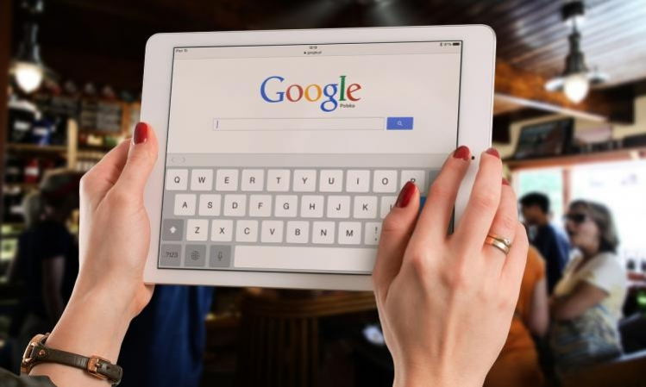

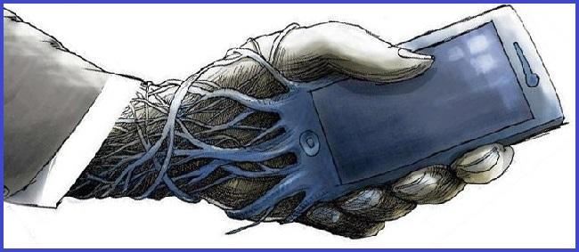

Slide 3
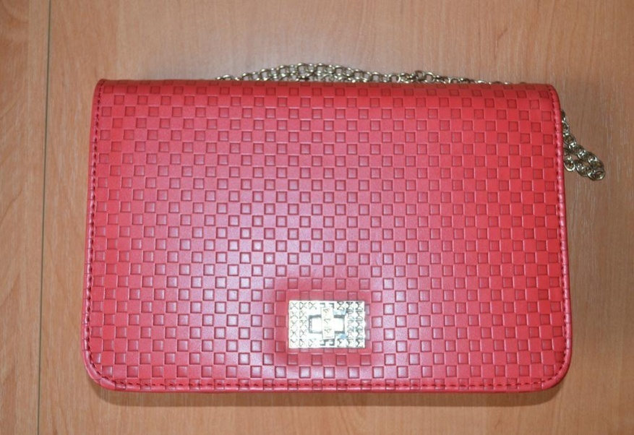
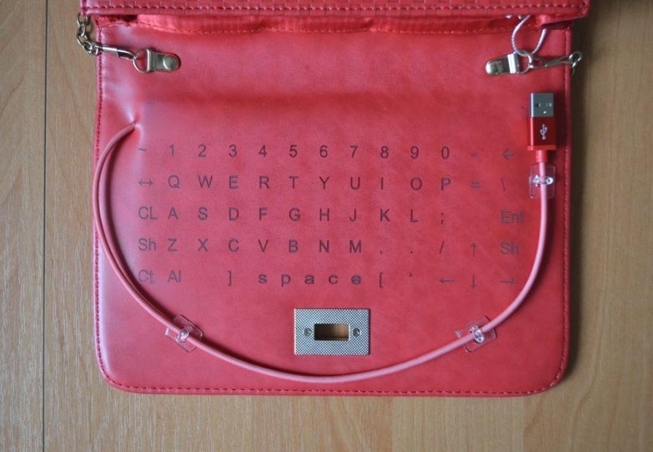
Clutch with built-in keyboard

Slide 4

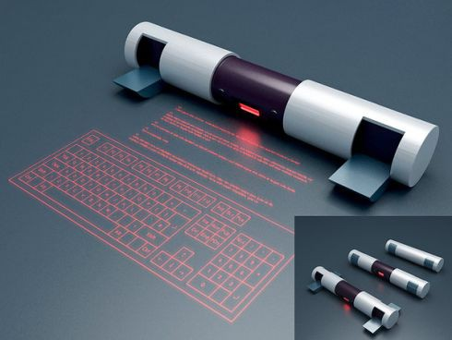
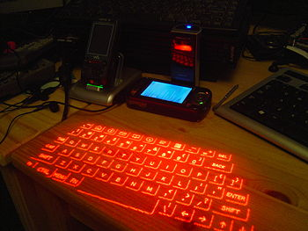

Projector keyboard.
Voice input systems.

Slide 5
Completed work:
Developed new composite materials, that providing the required quality of the optical contact between the carrier and the reading optical fibers, produced a pilot batch of material for optical-mechanical contacts.
Carried out development and optimization method of synthesis working of composite materials that capable of providing the required quality opto-mechanical contacts.

Slide 6
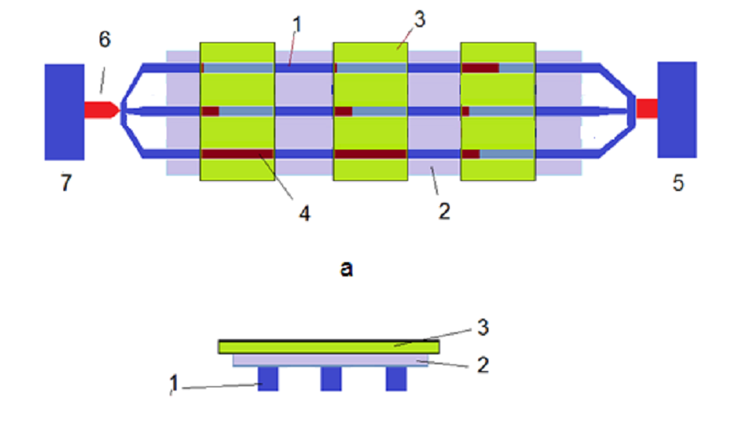
a
b
Optical coding scheme: a) - view from above, b) - a sectional view. 1 - supporting fibers 2 - coding mask, 3 – button/modulating optical fibers 4 - encoding slits in the mask 5 - radiation receiver 6 - a radiation source, 7 - the unit generating control signals.

Slide 7
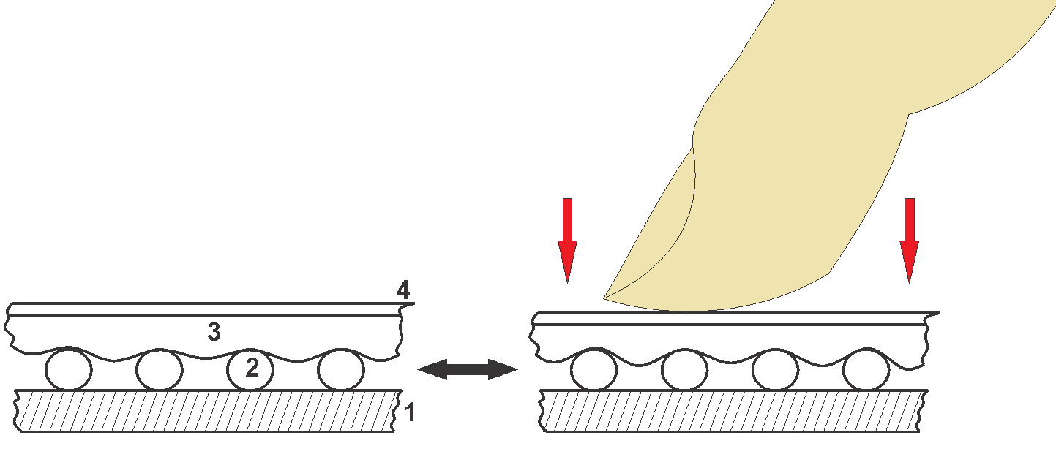
The design of the optical keys that use carrying fiber-optic. 1 - external enclosure, 2 - a fiber optic system, 3 - membrane made of developed composite material, 4 - outer cover.

Slide 8
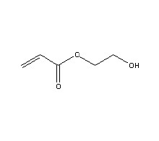


Material requirements
Providing reversible optical contact with the imposition of additional mechanical force.
Addressing the reverse button
The use of light scattering in the silica nanoparticles

Slide 9
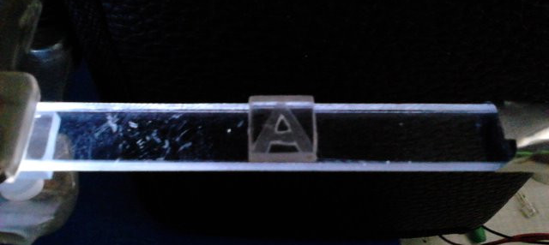
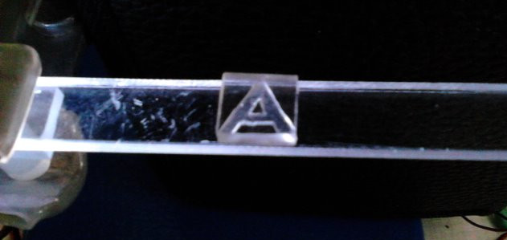
Alphabetic symbol, which located on a substrate made of organic glass in the absence of optical contact; visual perception - shaded symbol.
Alphabetic symbol, which located on a substrate made of organic glass with optical contact; visual perception – lighted symbol.

Slide 10
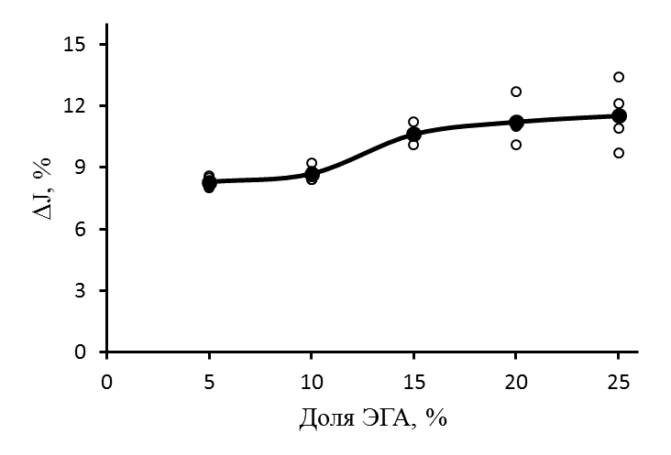
The dependence of the amplitude of the optical signal changes by mechanical action on the film on the percentage of EHA in a film based on a copolymer of BMA - EHA in the absence of nanoparticles.

Slide 11
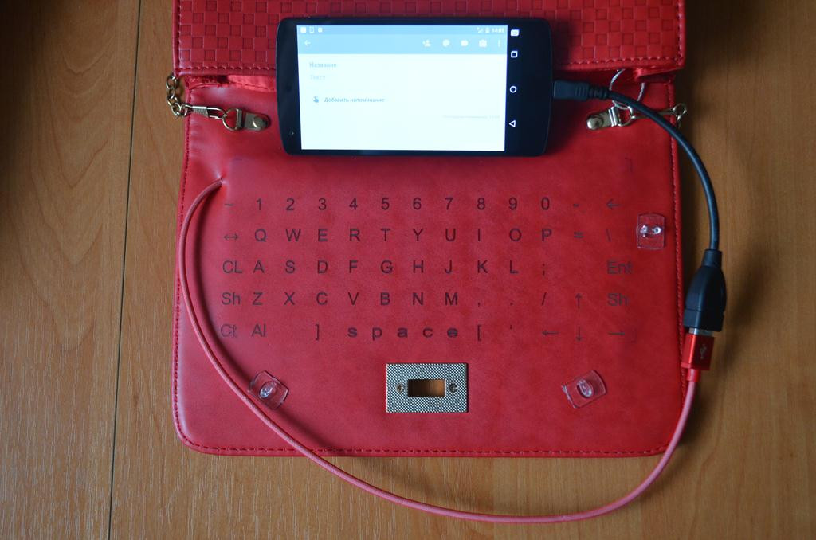
End-product
Benefits:
The weight of the bag is increased to 75 grams, which is not significant to the user.
There is the possibility to work in public in the usual mode qwerty-keyboard (ease of typing)
There is an opportunity to market souvenirs, exclusive products, etc.
Clutch connected to the communicator, which typed text.

Slide 12

Спасибо за внимание!

