Slide 1


DEVELOPMENT OF ELECTROCONDUCTIVE MATERIALS BASED ON METALLIZED POLYIMIDES AS ELEMENTS OF FLEXIBLE SOLAR CELLS
Rinat Iskakov
KBTU
Korean seminar October 23, 2015 год

Slide 2

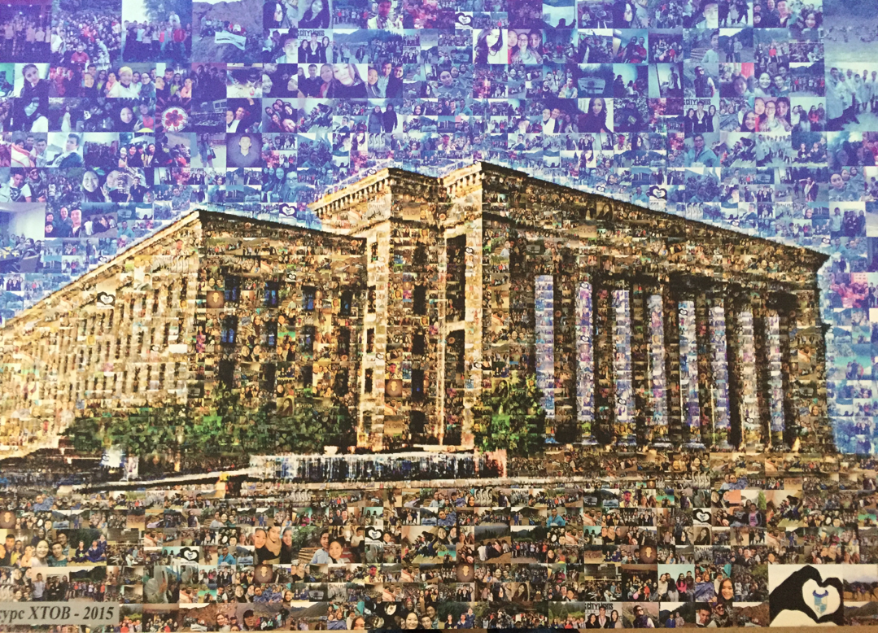
BAKDAULET SEIFULLIN,
ARAILYM IBRAIMBEK,
ERNUR TOLEP,
KAMSHAT UMBETOVA,
RINAT ISKAKOV
VICTORIA KHEGAY
riskakov@mail.ru r.iskakov@kbtu.kz http://www.chemistry.kz
Korean seminar October 23, 2015 год

Slide 3
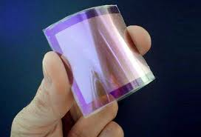
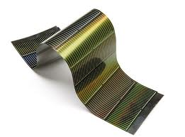
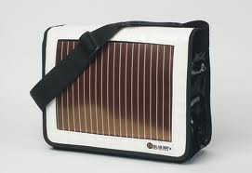
Korean seminar October 23, 2015 год

Slide 4
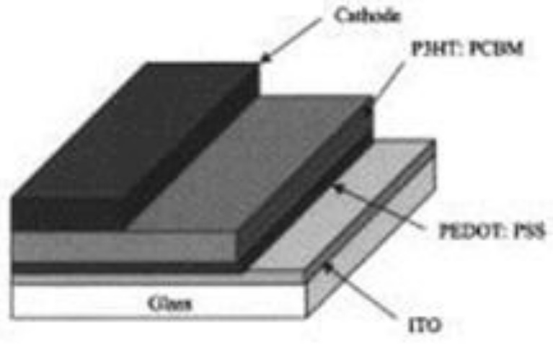
Conductive layer: PEDOT: PSS –
Acceleration & transportation of charge
Photoactive layer: P3HT/PCBM – semiconductive transmitter
Cathode: Metal for electron accumulation
Korean seminar October 23, 2015 год

Slide 5
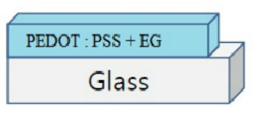
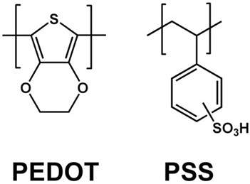
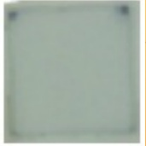
Quality standard is transparency degree
Transmission coefficient- more 85%
Resistivity of surface layer- less 100 (Ohm per sq.sm)
Volume EG %
Annealing temperature
Film thickness
1.5 см
1.5 см
Korean seminar October 23, 2015 год

Slide 6
1) Optimization of additive amount (EG)
Conditions: 5000 rpm, T = 150 ⁰С
Result: solution of 6% EG
Korean seminar October 23, 2015 год

Slide 7
2) Optimization of annealing temperature
Condition: 5000 rpm, р-р 6% EG
  Results: 140 ⁰С
Korean seminar October 23, 2015 год

Slide 8
3) Thickness optimization
Conditions: solution of 6% EG, T = 140 ⁰С
Korean seminar October 23, 2015 год

Slide 9
4) Surface resistivity vs transparency
Result: 800 rpm (126 нм) .
Korean seminar October 23, 2015 год

Slide 10
Optimal conditions
Amount of ethyleneglycol(EG) - 6%.
Annealing temperature 140 ℃
Film thickness 125 nm
Korean seminar October 23, 2015 год

Slide 11
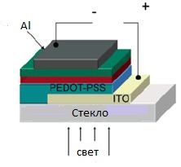
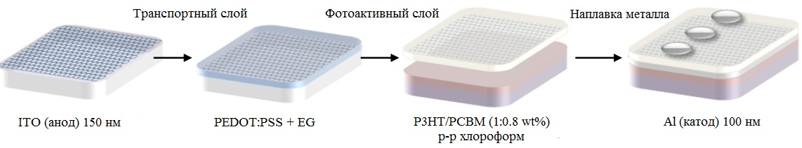
Optimization of active layer thickness
Optimization of drying temperature after annealing
Korean seminar October 23, 2015 год

Slide 12
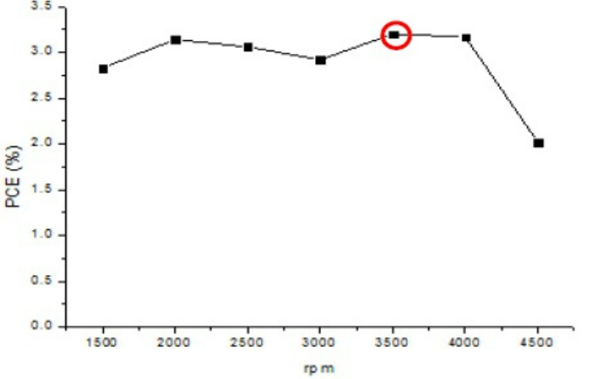
1) Optimization of active layer thickness
Result: 3500 rpm (90 nm) .
Korean seminar October 23, 2015 год

Slide 13
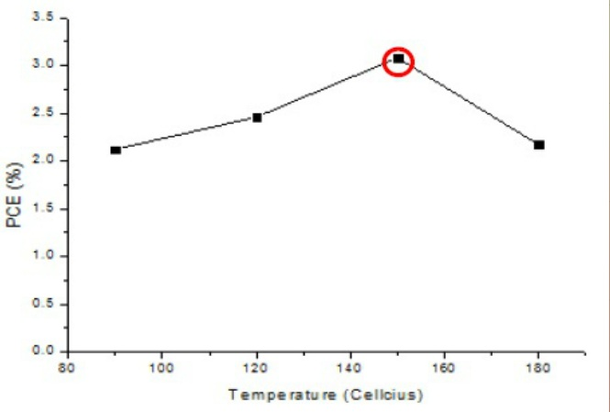
2) Temperature optimization after annealing
Results: 150 ℃ .
Korean seminar October 23, 2015 год

Slide 14
Thickness of the active layer at 3500 rpm (90 nm)
Temperature after annealing- 150 ℃
PCE мax: 3.3 % (transmittance efficiency)
Korean seminar October 23, 2015 год

Slide 15

Metallized PI film
PI film
Alkali hydrolisys
Ion chelation
Metal reduction
Annealing
50-100 nm
Korean seminar October 23, 2015 год

Slide 16
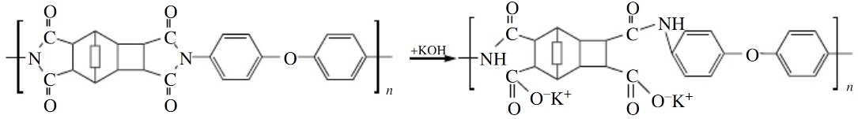
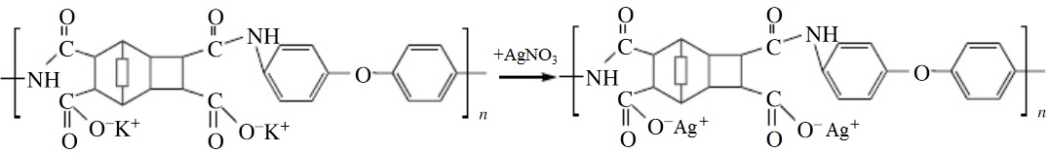
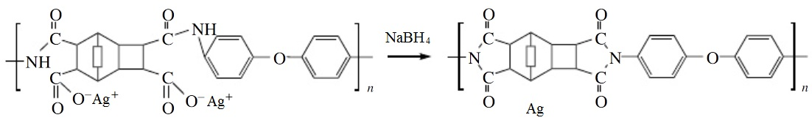
1. Alkali hydrolisys
2. Ion chelation
3. Metal reduction
Korean seminar October 23, 2015 год

Slide 17
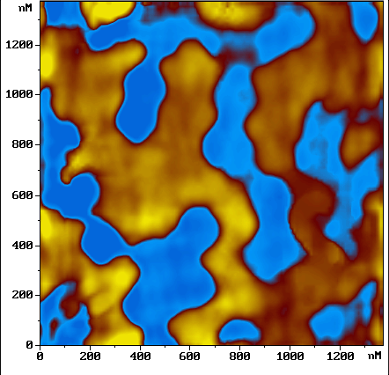
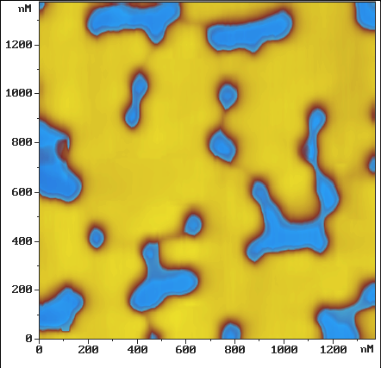
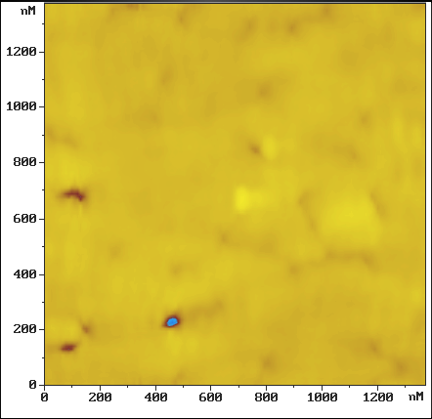
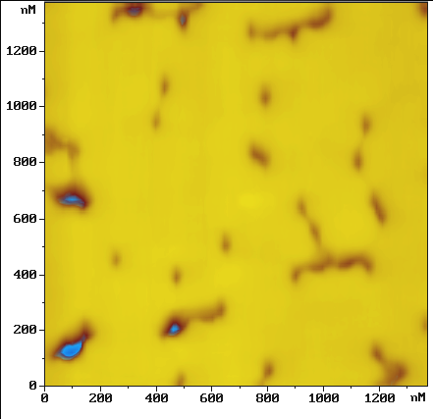

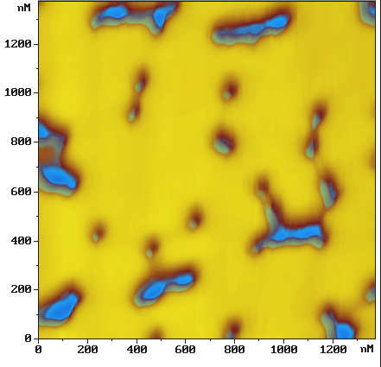
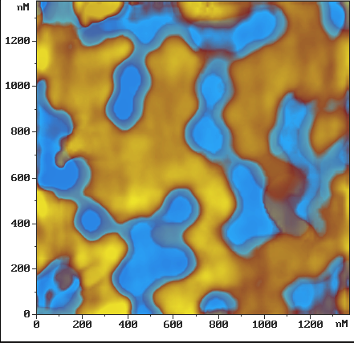
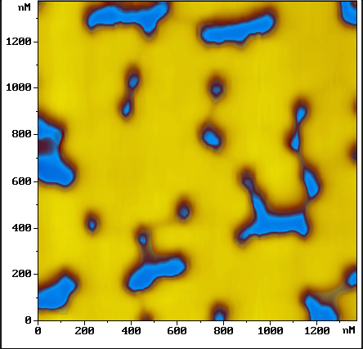
Ag
ПИ
Ag
PI films concentrate Ag crystals at the surfaces
Korean seminar October 23, 2015 год

Slide 18
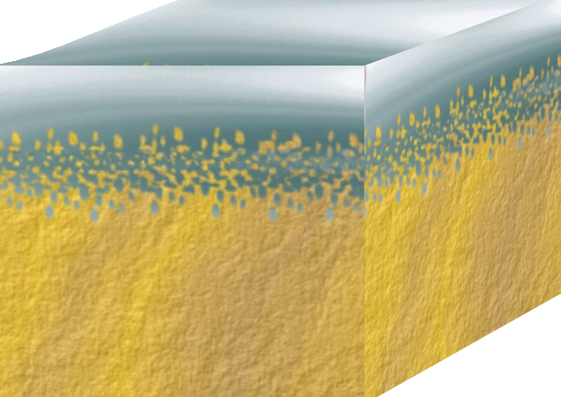
METALL
POLYIMIDE
Ag
Metal nanostructures with “dead adhesion”
Korean seminar October 23, 2015 год

Slide 19
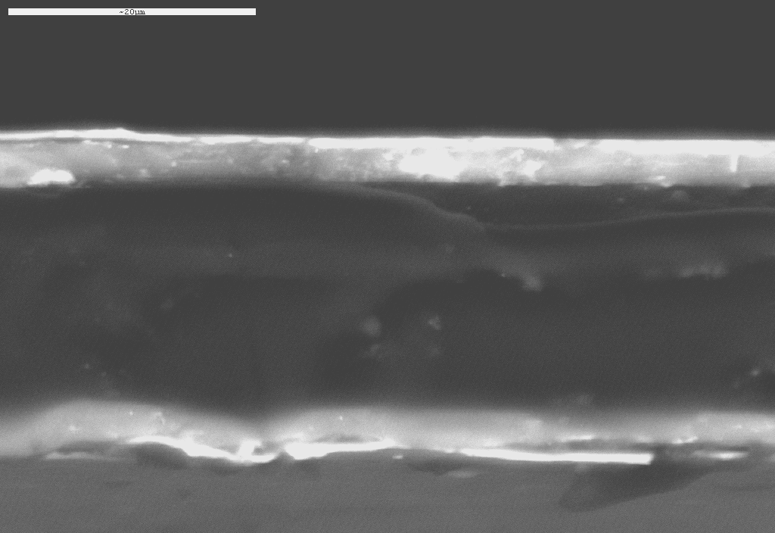
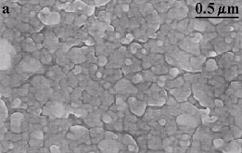
c
Korean seminar October 23, 2015 год

Slide 20
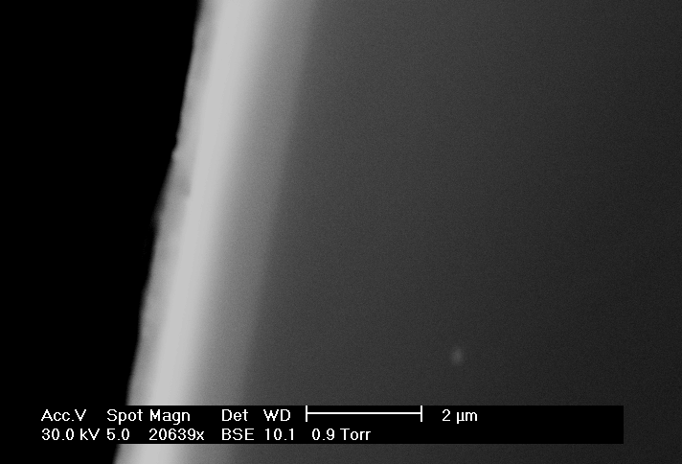
POLYIMIDE
METALL
Korean seminar October 23, 2015 год

Slide 21
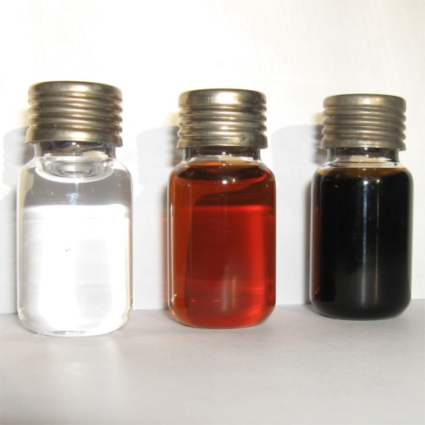
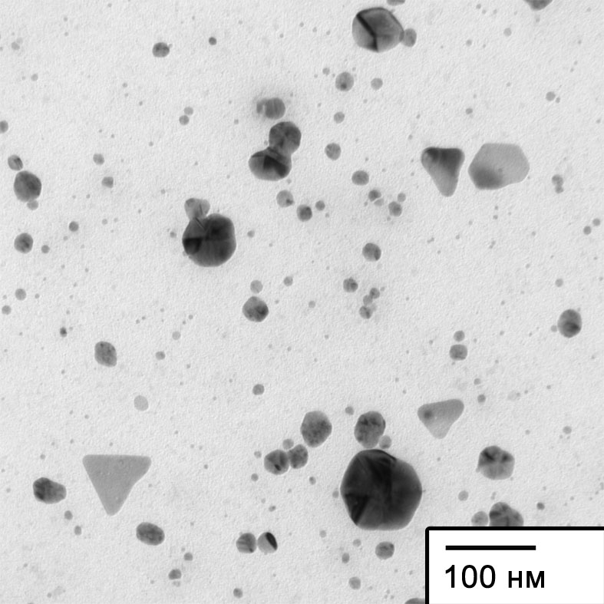
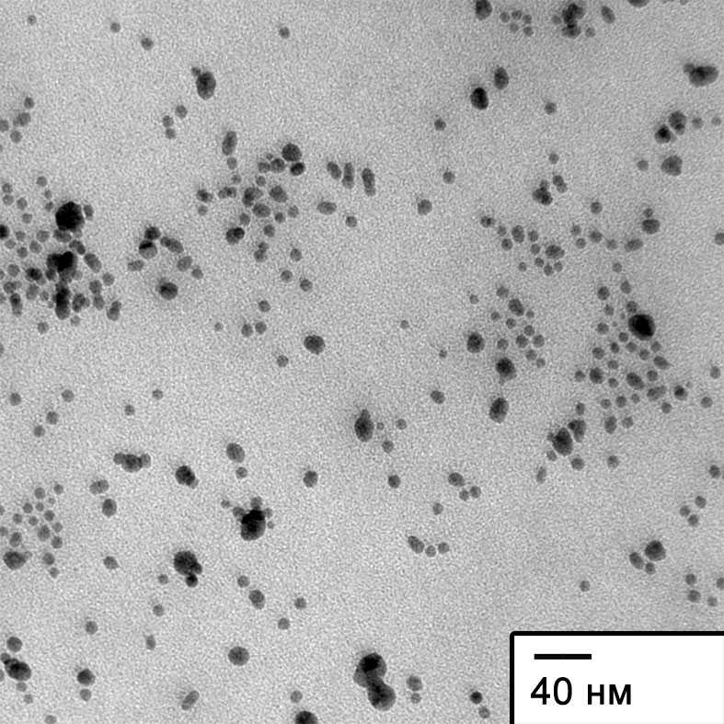

From left: the initial solution; during; and after synthesis
TEM of silver nanoparticles
AgNO₃
AgAc
Diffraction
Korean seminar October 23, 2015 год

Slide 22
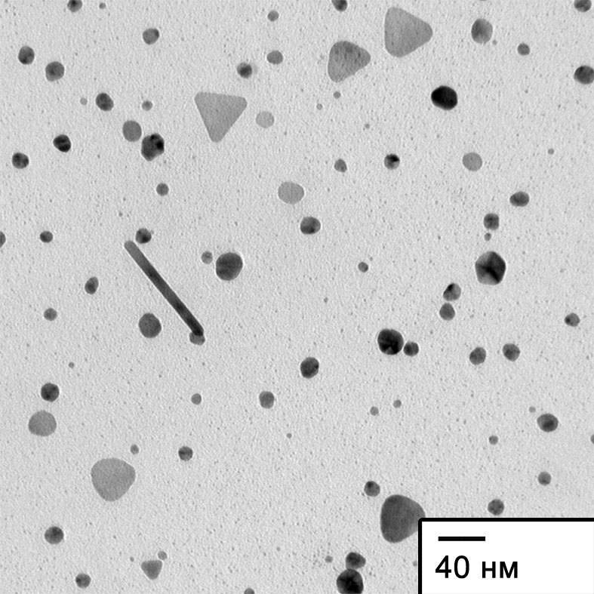
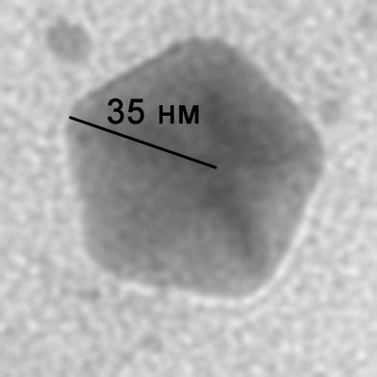
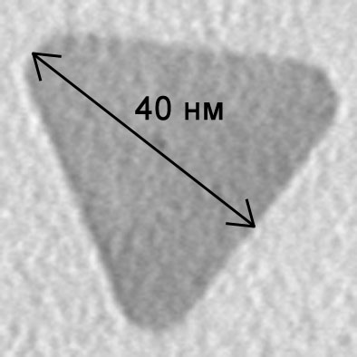
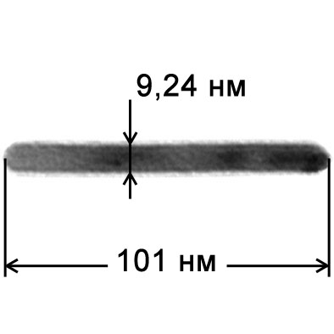
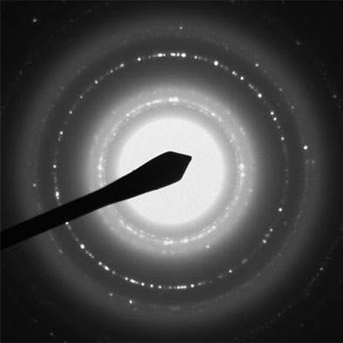
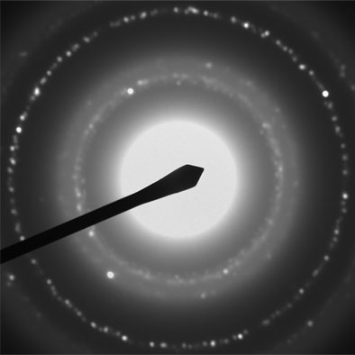

TEM of silver nanoparticles in DMFA
а
б
в
Korean seminar October 23, 2015 год

Slide 23
Dependence of plasmon max of silver nanoparticles on synthesis duration
Salt AgNO₃ (●) and AgAc (○) in DMFA (а) and ethanol (б)
Korean seminar October 23, 2015 год

Slide 24
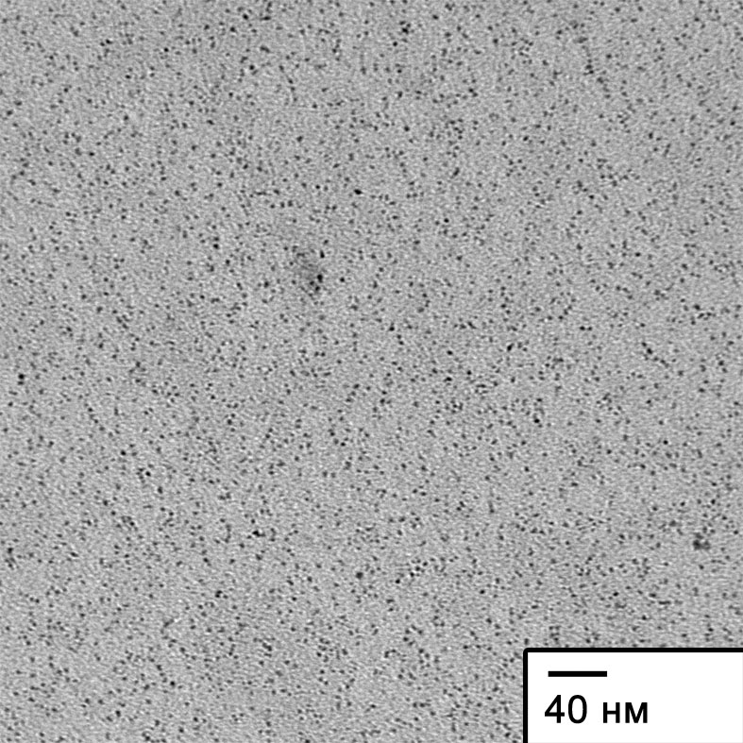
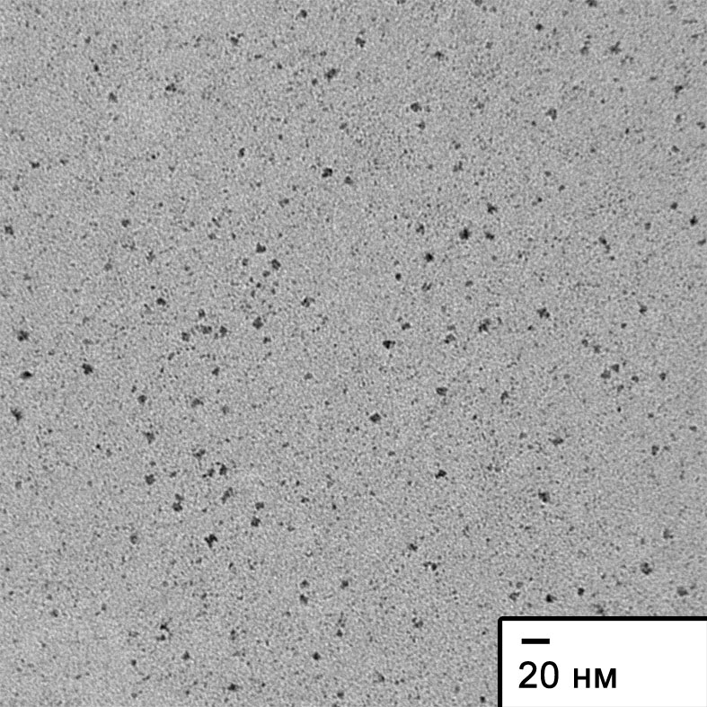
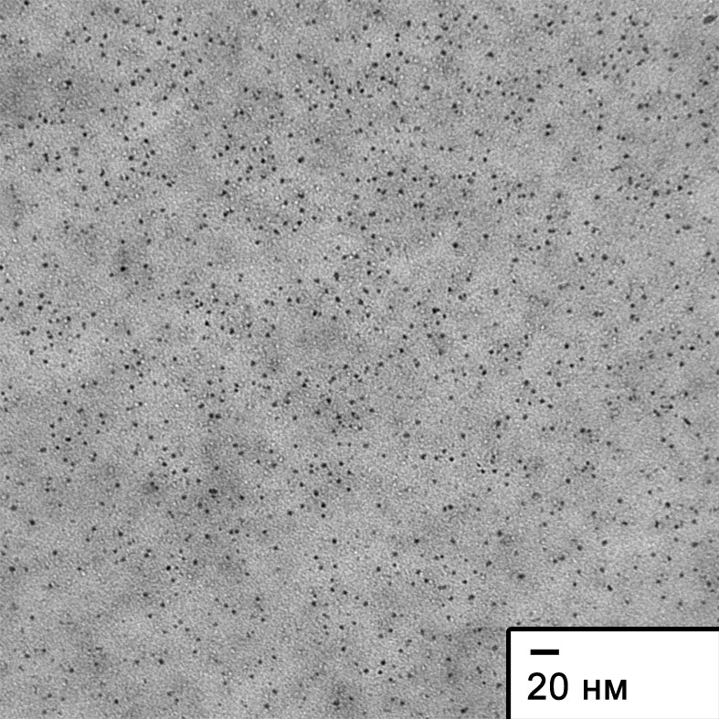
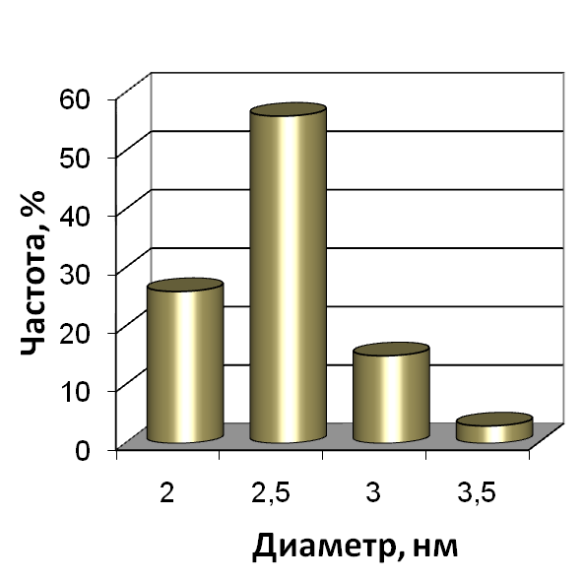
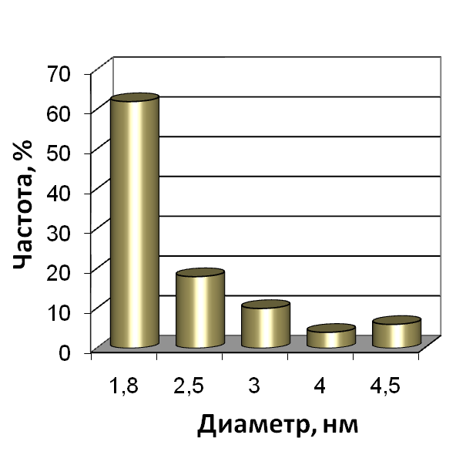
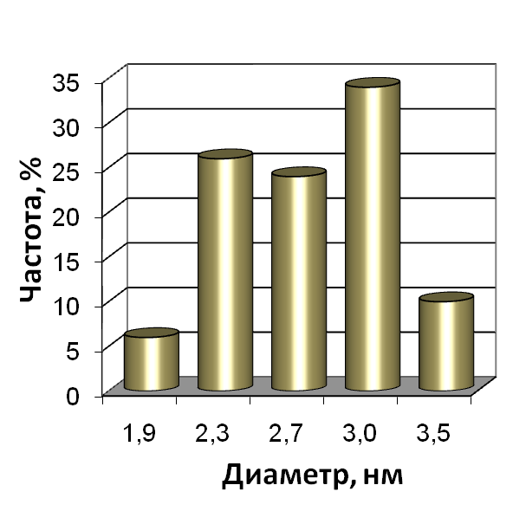
а
б
в
DMFA
DMSO
DMFA
TEM of Co (а, б) and Ni (в) nanoparticles and their size distribution
Korean seminar October 23, 2015 год

Slide 25
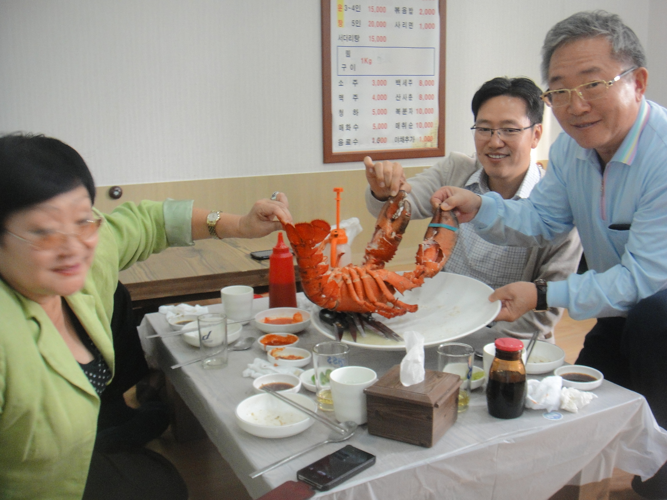
감사합니다
riskakov@mail.ru r.iskakov@kbtu.kz http://www.chemistry.kz
Korean seminar October 23, 2015 год

