Slide 1
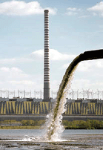
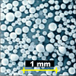
MICROSPHERES – APPLICATION PROSPECTS AS SORBENTS IN ENERGY SAVING TECHNOLOGIES

Slide 2
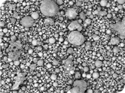
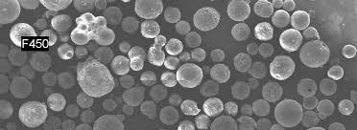
what is a cenosphere?
The cenosphere is a lightweight, inert, hollow sphere made largely of silica and alumina and filled with air or inert gas., typically produced as a byproduct of coal combustion at thermal power plants. The color of cenospheres varies from gray to almost white and their density is about 0.4–0.8 g/cm³

Slide 3
Area of application
Cenospheres are being used in different industrial applications, mainly due to their low density, high strength, and good thermal properties. However, it is important and mandatory to study and characterize these ash particles for a better and effective usage.
Cenosphere
oil production and chemical industry
Building Industry
refractory Industry
polymer industry
abrasive highly porous materials
nylon, plastic, and other materials of different densities
materials for oil wells
lightweight refractory material
insulation and roofing surfaces
drilling mud
insulating materials
vehicle structure
explosives
dry mix
lime mixtures
repair filler and primer
defoamers
mastic, plaster
catalysts
composites
super lightweight concretes
tires, bumpers and panels
sound proof
materials
sound proof materials

Slide 4
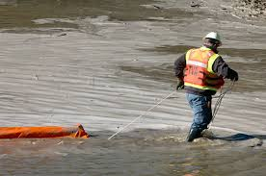
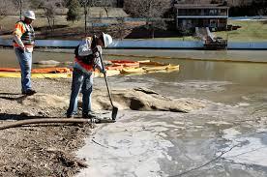
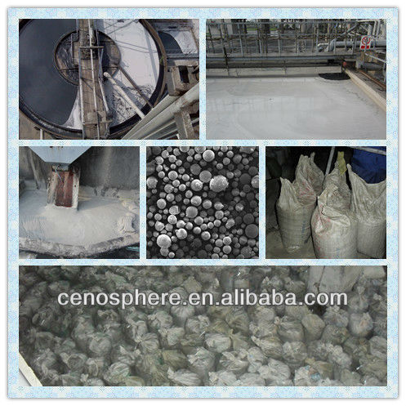
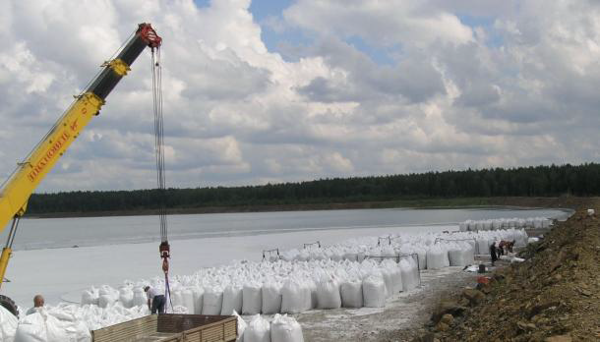
Extraction of microspheres
The apparent density of cenospheres is less than that of water and they float on the ash slurry. This property of the microspheres is used to collect them from the surface of technological water solutions of power station with a small nets or using of flotation methods
Russia, Kazakhstan
China

Slide 5
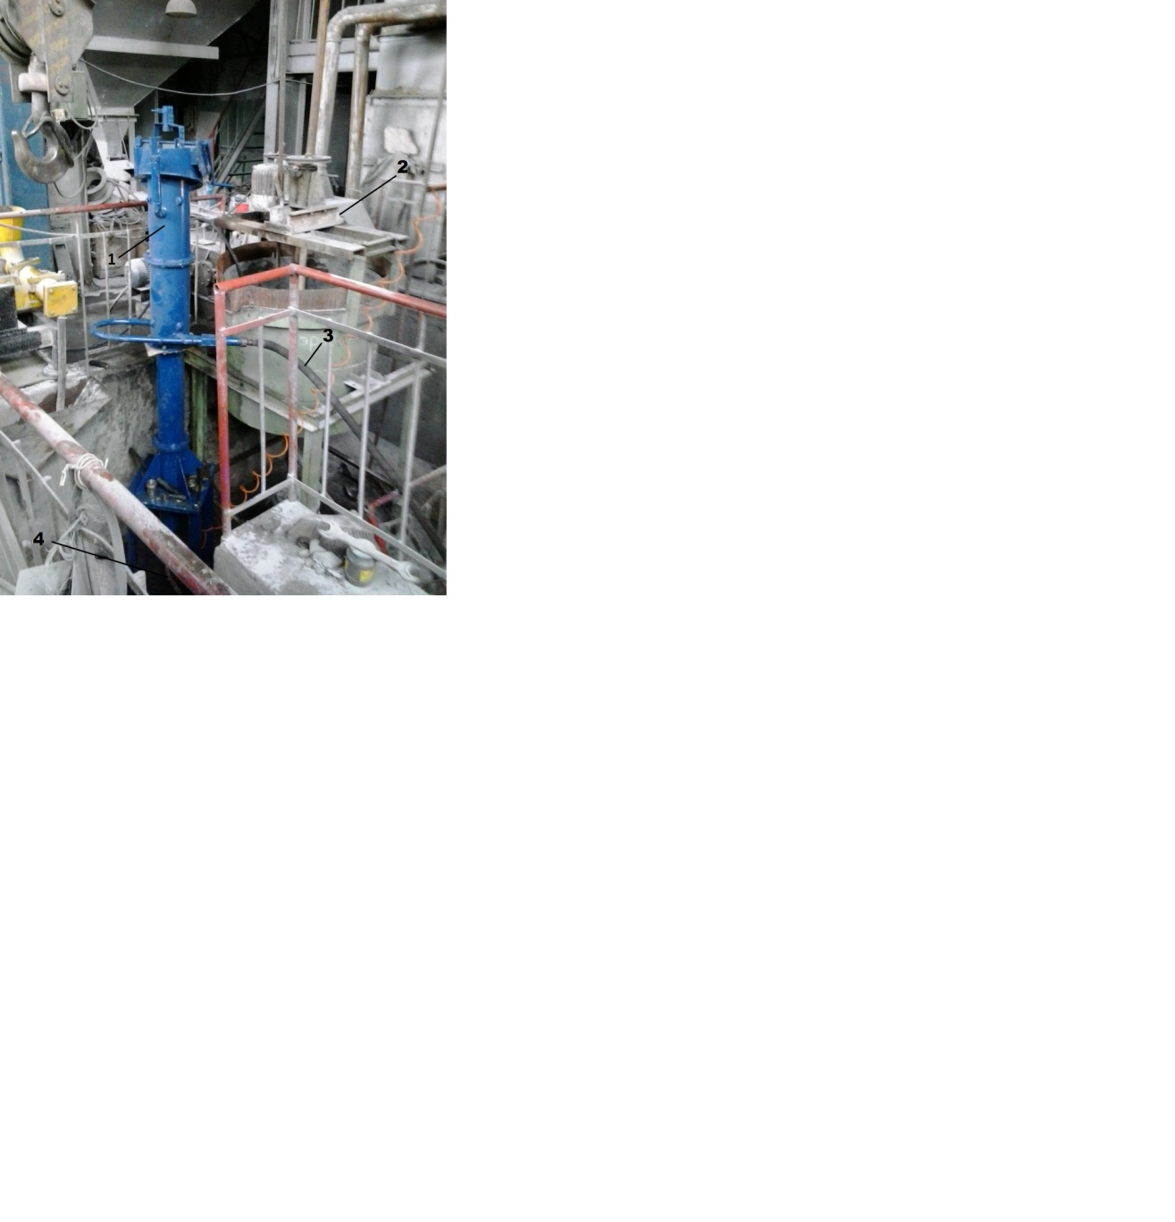
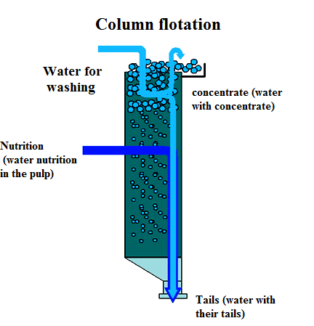
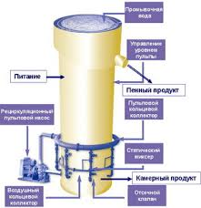
Scheme of column flotation
The column flotation based on different principle distribution of water between the foam and the chamber product showed the possibility of obtaining a more rich concentrates and diminish several stages of purification processes of mineral materials

Slide 6
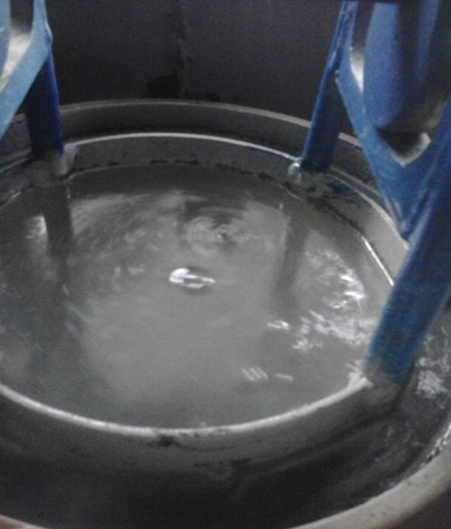
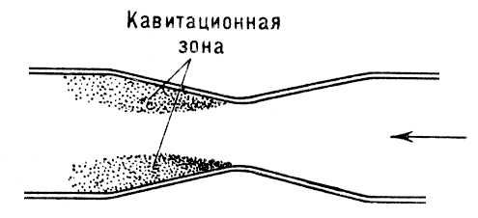
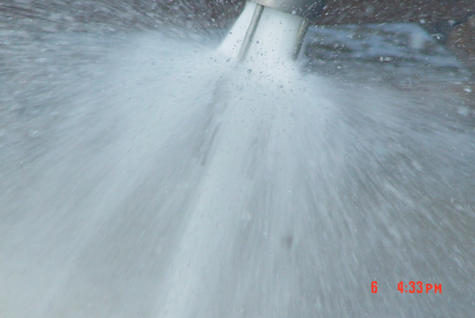
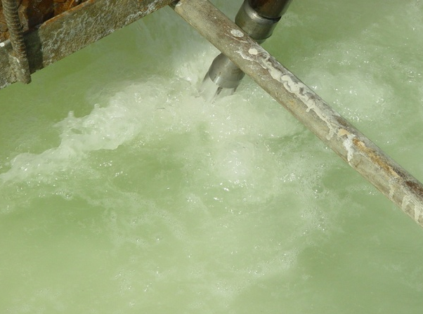
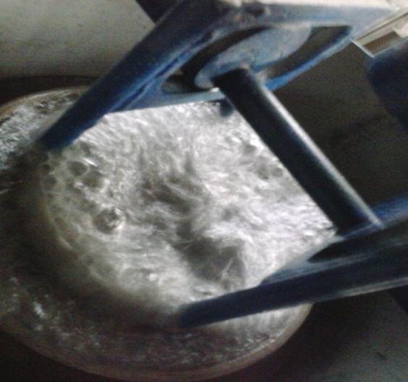
Separation of microspheres by using of column flotation cell
a)
b)

Slide 7
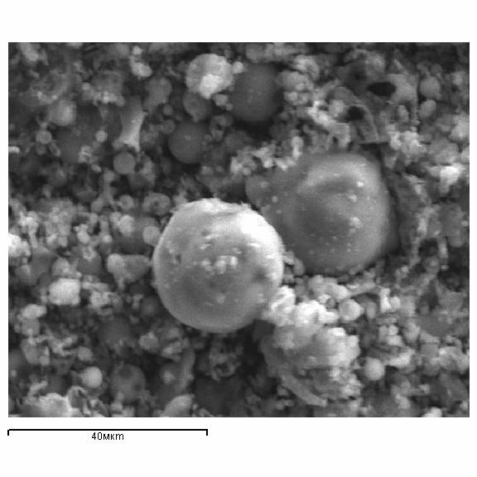
The results of analyses
Спектр | В стат. | O | F | Mg | Al | Si | S | K | Ca | Ti | P | Fe | Na | Cl | ИТОГО
Спектр | Да | 48,96 | 0,66 | 0,26 | 18,31 | 24,45 | 0,09 | 0,42 | 2,18 | 1,01 | 0,65 | 2,53 | 0,37 | 0,11 | 100,00

Slide 8
Where and how we can use them?

Slide 9
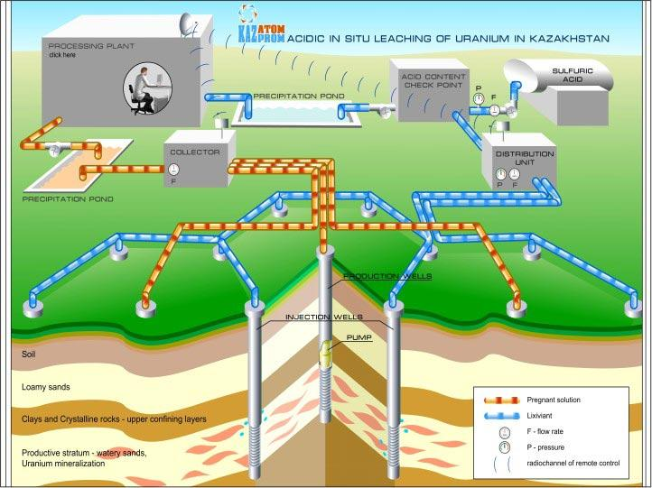
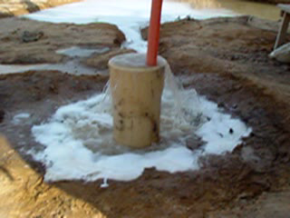
Diagram in-situ leaching of uranium
Sometimes is taking place a spills of uranium solutions to the land

Slide 10
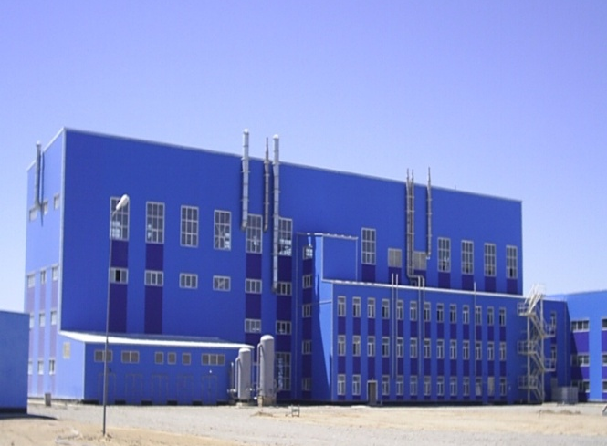
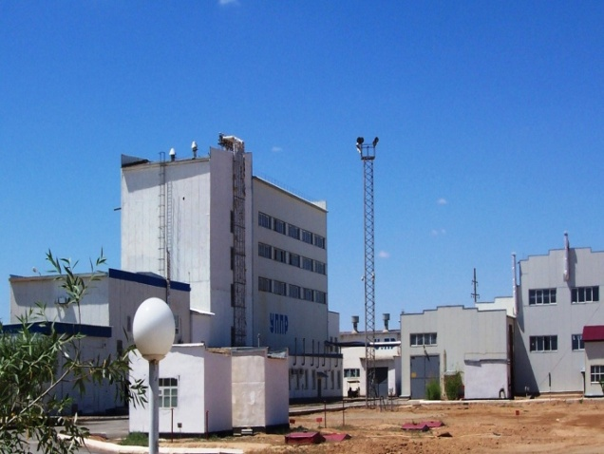
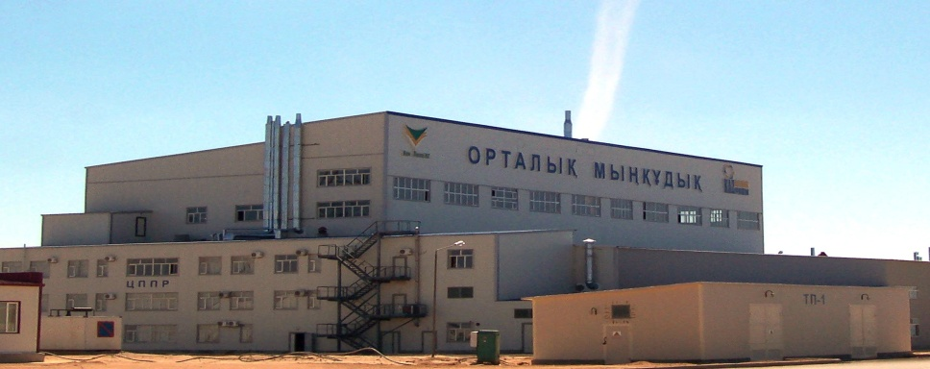
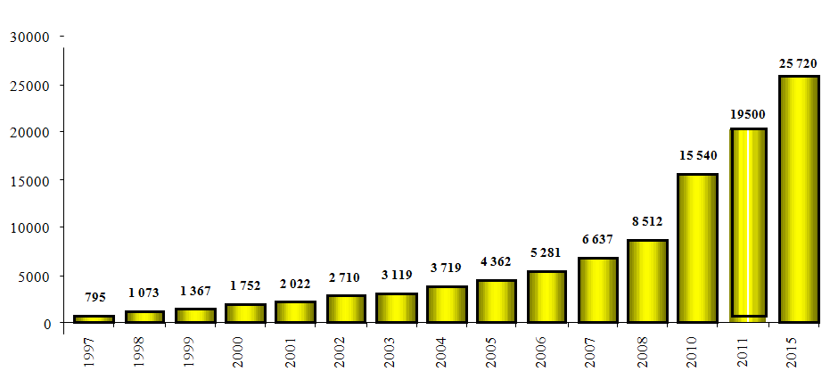
Uranium mines

Slide 11
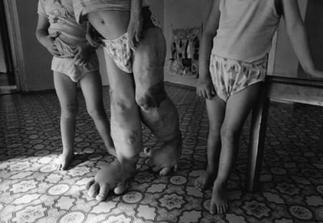
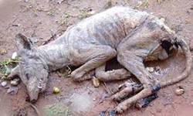
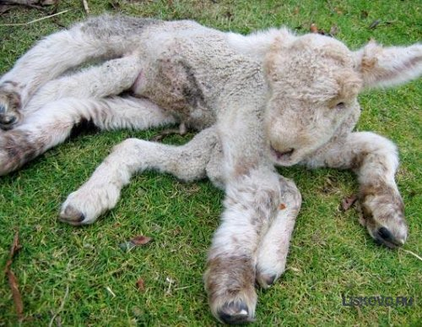
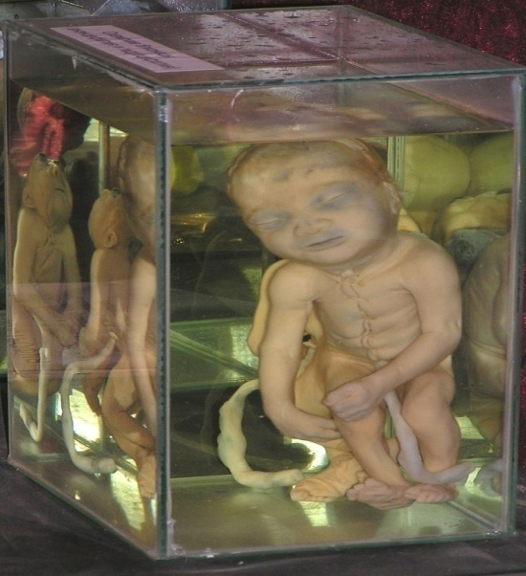

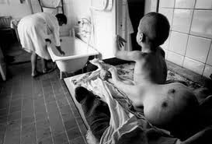
The influence of radiation on a living organism
The Consequences of the Chernobyl Nuclear Power Plant and Semipalatinsk nuclear polygon

Slide 12
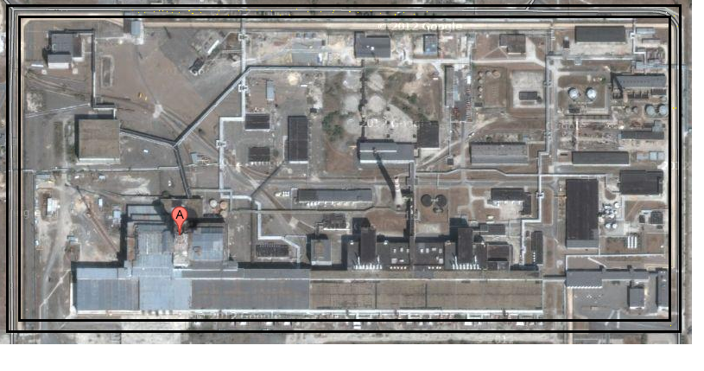
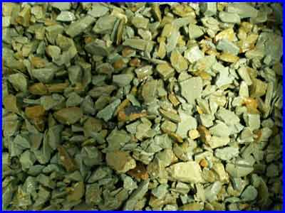
Geotechnological barrier around Chernobyl nuclear power station
They filled out the trench of ceolites to prevent ingress of radioactive water into the river
Ceolit

Slide 13
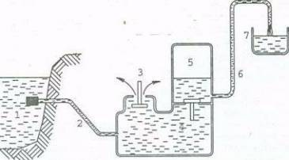
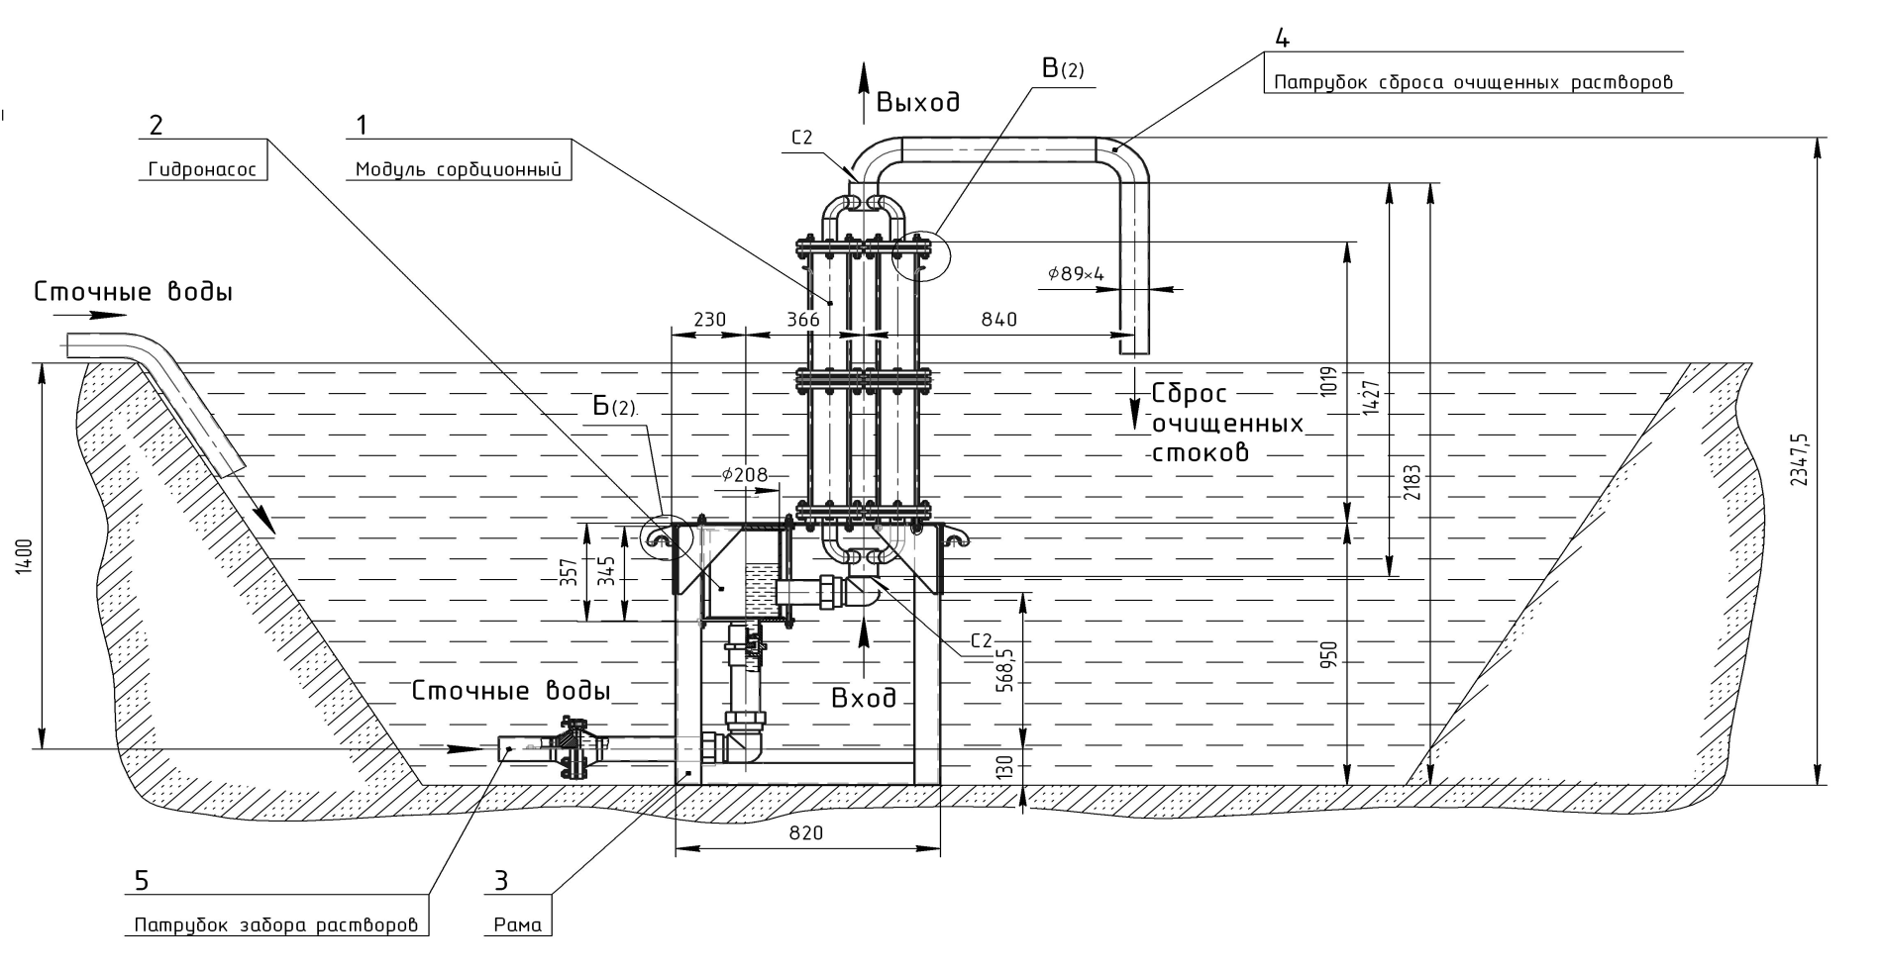
An accommodation option of filters in sewage ponds

Slide 14
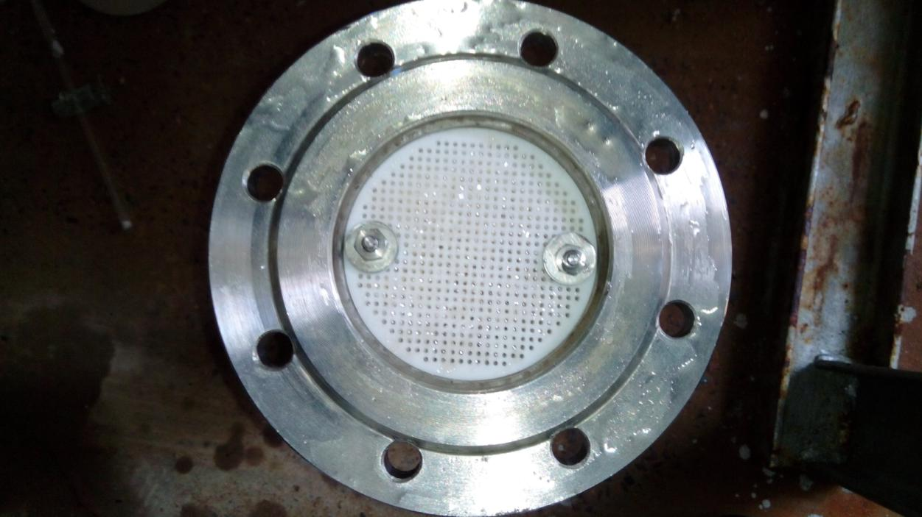
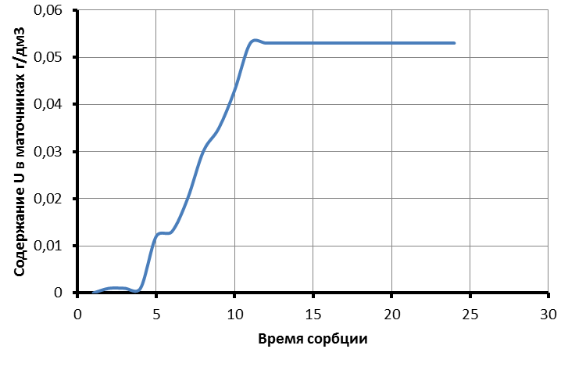
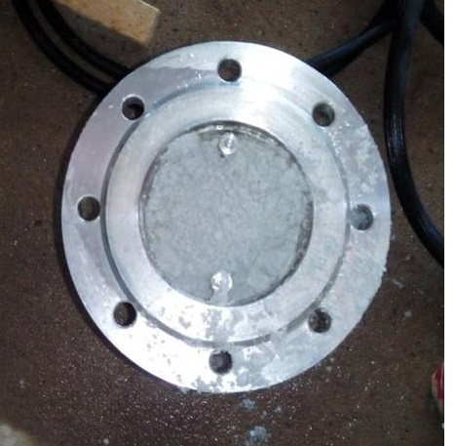
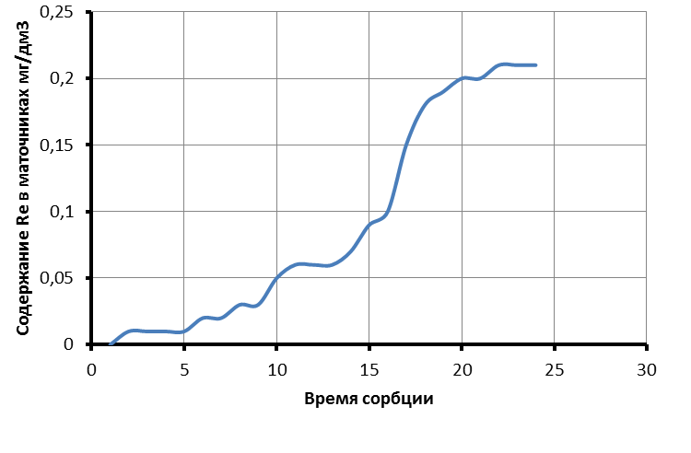
Experimental and technological testing
Sorption of uranium and rhenium

Slide 15
Content of uranium and iron infiltrate
№ | № sample | Time, hour | Content of U in solution, мg/dм³ | Content of Fe solution, мg/dм³
0 | 0 |  | 53,63 | 657,4
1 | 3.1 | 2 | 42,66 | 387,4
 | 3.2 | 4 | 42,13 | 408,5
 | 3.3 | 6 | 40,30 | 404,9
2 | 4.1 | 2 | 39,19 | 510,6
 | 4.2 | 4 | 41,68 | 476,6
 | 4.3 | 6 | 41,22 | 449,4
3 | 7.1 | 2 | 35,61 | 190,2
 | 7.2 | 4 | 23,82 | 316,9
 | 7.3 | 6 | 31,37 | 244,9
 | Обьем на выходе | Металл, г/л | Степень извлечения по металлу, % | Кислотность, г/л
Темирт. Исх. | 5 | 37,18 | 61,27 | 4,9
Темирт. Кис. | 4 | 30,92 | 74,23 | 3,43
Темирт. Щел. | 4 | 14,33 | 88,06 | 0
Экиб. Исх. | 5 | 44,2 | 53,96 | 3,675
Экиб. Кисл. | 4 | 51,6 | 57,00 | 4,9
Экиб. Щел. | 4 | 39,89 | 66,76 | 0
Исх. Алматы | 6 | 80 | 0,00 | 3,92

Slide 16




Members of our team
Leksin M.
Tyumenceva O.
Kononov A.
Oserov T.

Slide 17
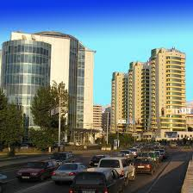
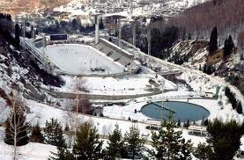
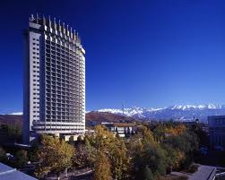
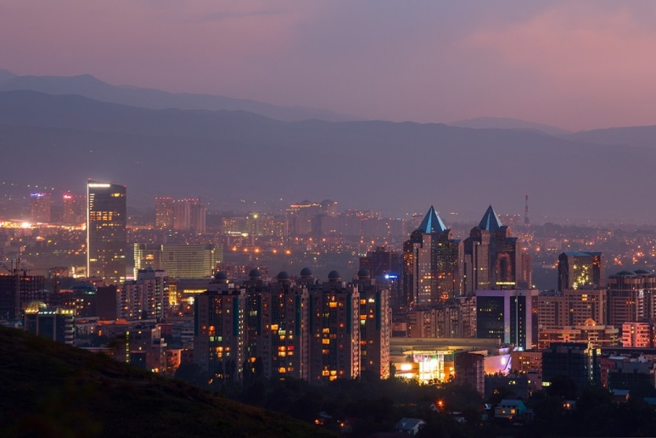
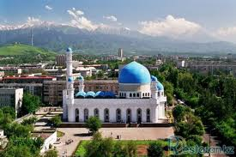
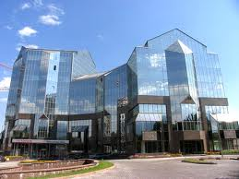
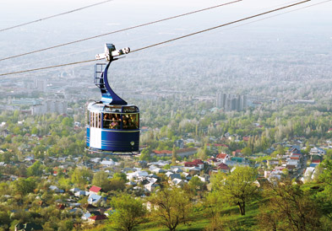
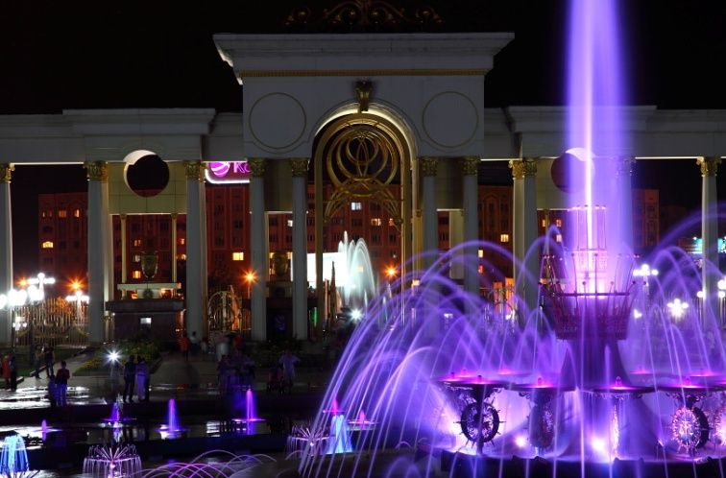
Almaty

Slide 18
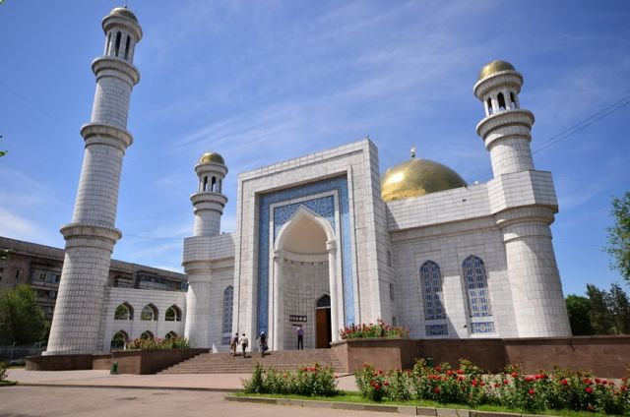
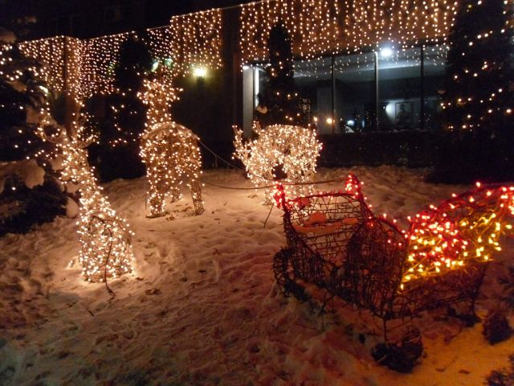
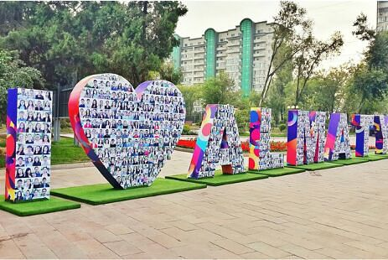
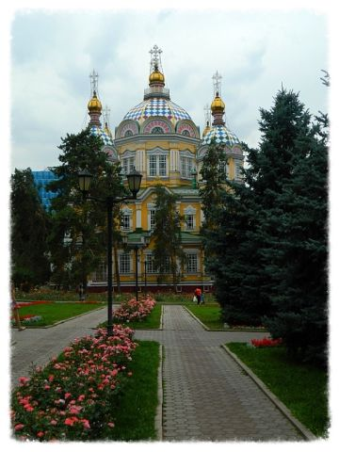
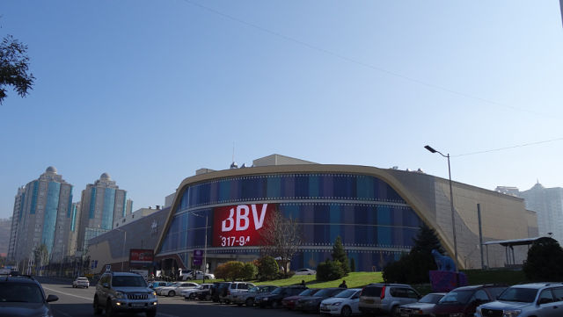

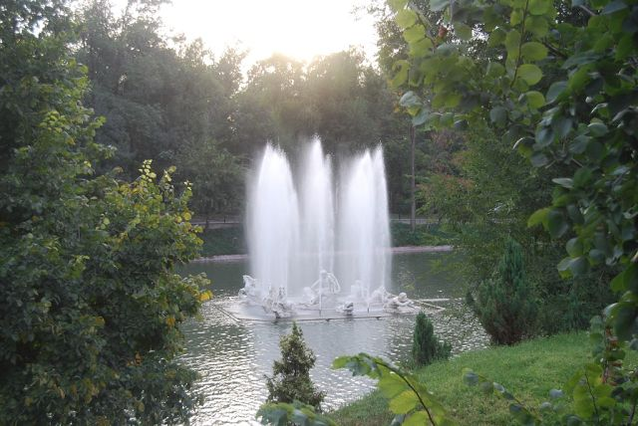



Slide 19
Thank you for attention!

