Slide 1
Al-Farabi Kazakh National University
Almaty University of Power Engineering and Telecommunications
National Engineering Academy of the Republic of Kazakhstan
DEVELOPMENT OF NEW ENERGY
SAVING SYSTEM WINDOW/TV
SCREEN
Grigoriy A.Mun,
Department of Chemistry & Technology of Organic Materials,
Polymers and Natural Compounds, KazNU

Slide 2
Know-How
Know-how subject – a light scattering thermo-sensitive polymeric composite
The work started in 2007 as part of the collaboration between the National Engineering Academy of the Republic of Kazakhstan (NIA), Al-Farabi Kazakh National University, Almaty University of Power Engineering and Telecommunications, Sevastopol National University (Ukraine/Russia), Institute of Macromolecular Chemistry (Czech Republic)

Slide 3
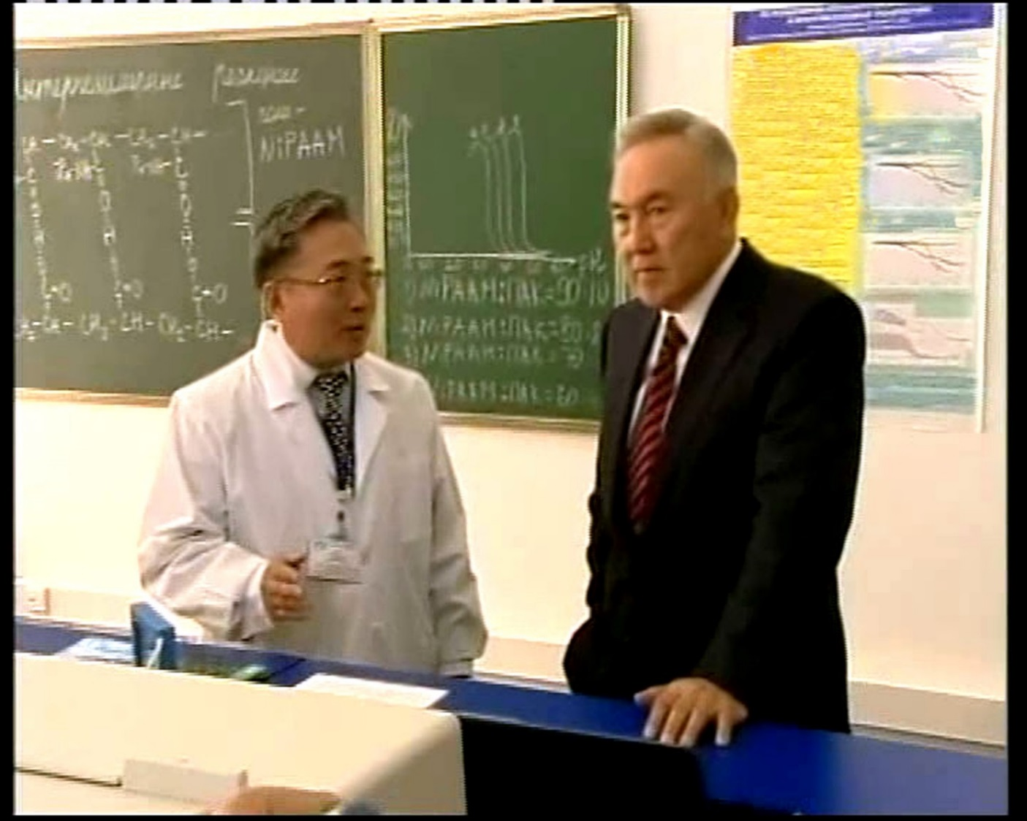
History
In 2009 initial results of the work demonstrated to the President of Kazakhstan Nursultan Nazarbayev during the event dedicated to the 75th Anniversary of Al-Farabi Kazakh National University, and received the necessary support and encouragement

Slide 4
Thermo-sensitive behavior
Macromolecule coil shrinks due to increasing of hydrophobic interactions magnitude
Thermal shrinking of macromolecules correspond to collapse of cross-linked polymer network

Slide 5
THERMO-SENSITIVE POLYMERS
PVME – poly(vinyl methylether)
PNIPAM – poly(N-iso propylacrylamide)
Widely used thermo-sensitive polymers contain both hydrophobic and hydrophilic groups in each monomer unit

Slide 6
Thermo-sensitive copolymers
VEEG-VBE
VEEG-ViBE
VEDEG-VBE
VEEG-HEMA
HEA-HEMA
HEA-VBE
HEA-BA

Slide 7
Thermo-sensitive polymer water solution

Slide 8

New Image Reproduction Systems based on thermo-sensitive polymers
1
1 – screen fulfilled by solution of thermo-sensitive polymer,
2 – light source,
3 – light-scattering region
3
3
2
During solution heating local phase transition takes place.
Pixels that scatter light will be perceived as bright ones
Fully transparent pixels will be perceived as dark ones

Slide 9
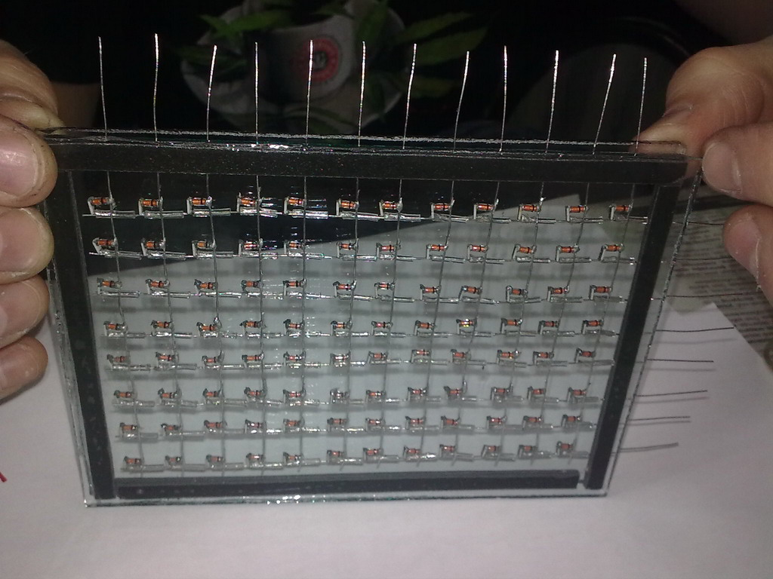
Matrix of demonstrational version of proposed screen
Contacts
Diodes
Resistors

Slide 10
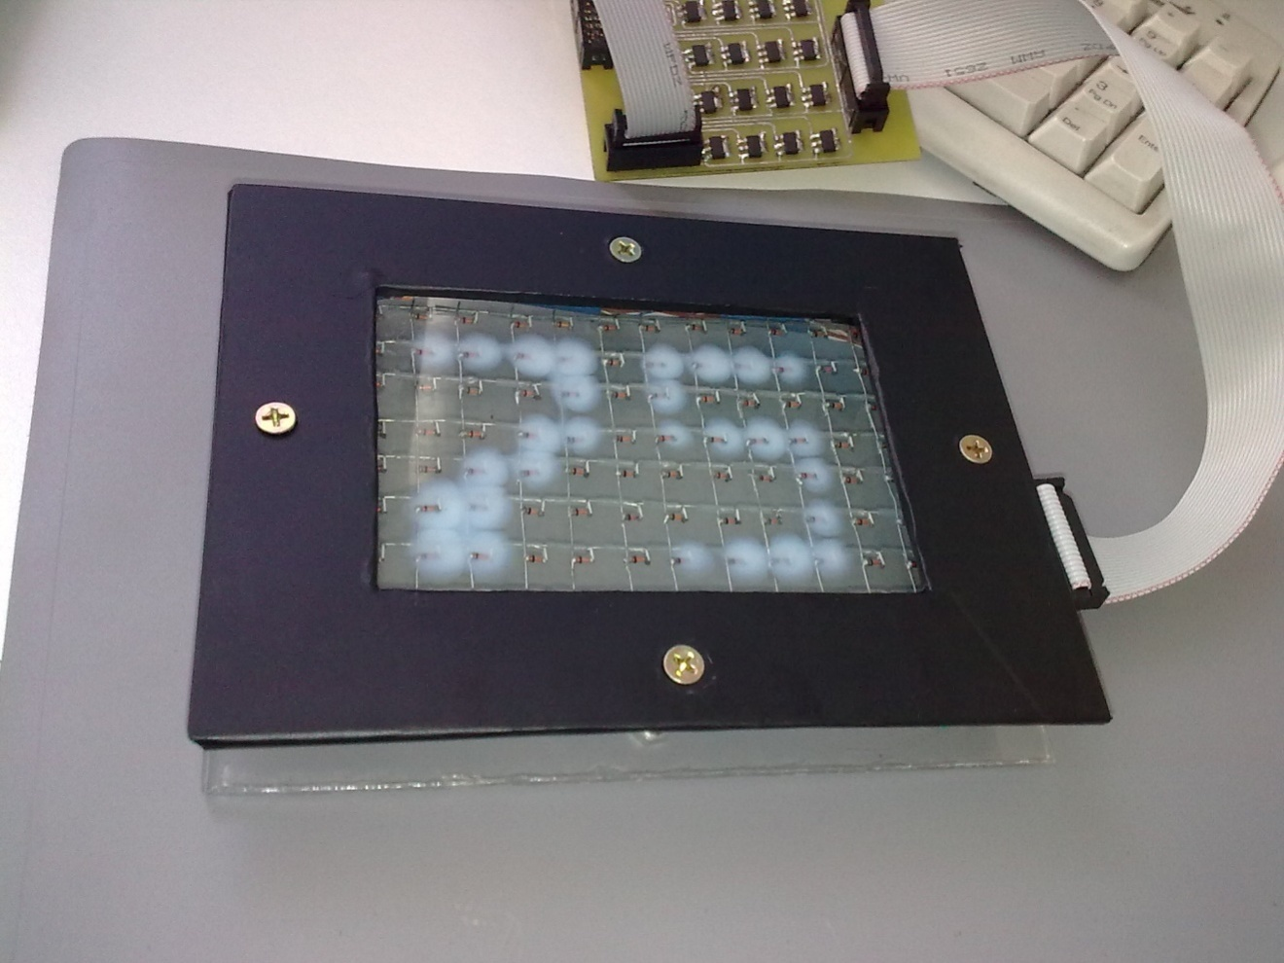
Demonstration of work
Working example of proposed type of screen was chosen to demonstrate to the President of Kazakhstan N.Nazarbayev during his visit to
Al-Farabi Kazakh National University in 13 October 2009

Slide 11
Illustration for the principle of the screen, using the light-guide properties of flat glasses and light-scattering materials
а)
б)
а) – path of ray in flat light-guide, б) – the occurrence of illuminance upon application of the additional light-scattering coating.

Slide 12
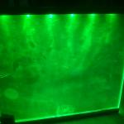
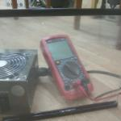
Photographs of the lightguide – light scattering system based on organic glass and light scattering film during on (a) and off (b) light sources
а
б

Slide 13
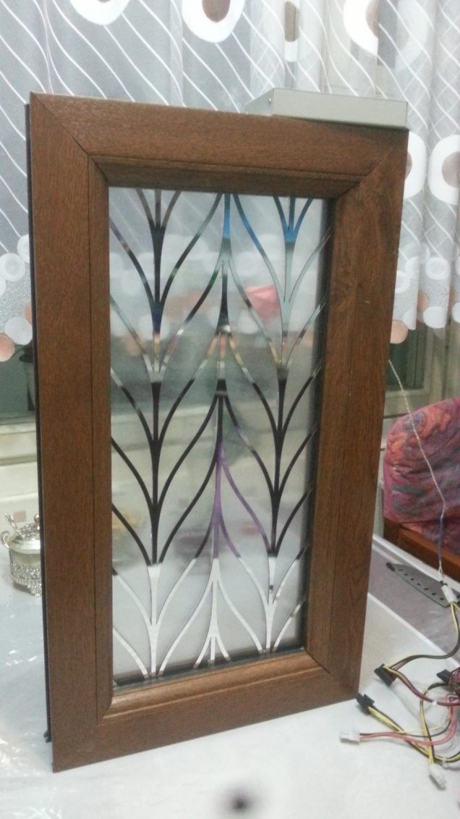
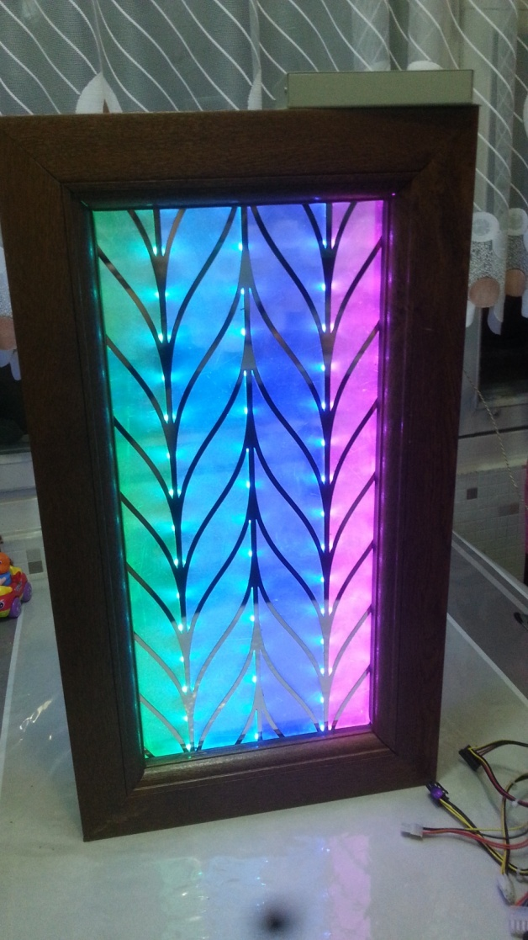
The main advantage
During the daytime system represents itsels as the stained glass window. At night the system switches to the TV screen mode
Frequency characteristics are fully meet current television standards

Slide 14
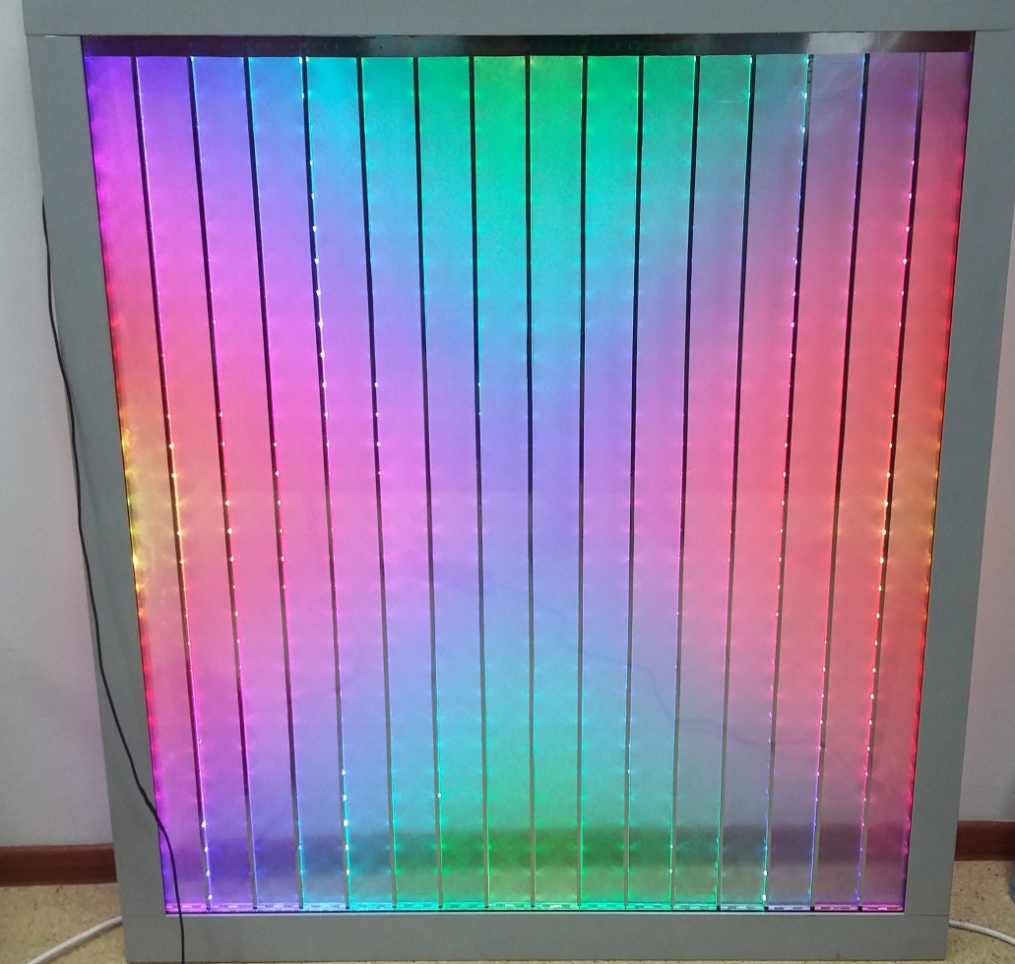
Pilot production
“Iglikov’s Laboratory” Ltd., was organized in May 2015, Almaty
Assembling the screen is made of standardized modules with 1.05 by 1.07 m sizes
Blocks are standard double-glazed windows, inside which are mounted :
lighting system;
control electronics;
Scheme of individual block is shown in Figure

Slide 15

Scheme of assembly stained-glass screen
A set of standard modules, assembly technology is identical to technology of installation of windows based on double-glazed window; it is allowed to produce of stained-glass of art complex shape

Slide 16
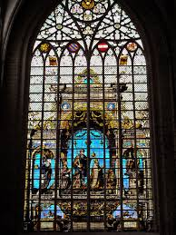
The prototype of art stained-glass windows
Vintage design solutions, providing decoration lighting system, run on the basis of Gothic stained-glass windows (Czech Republic)

Slide 17
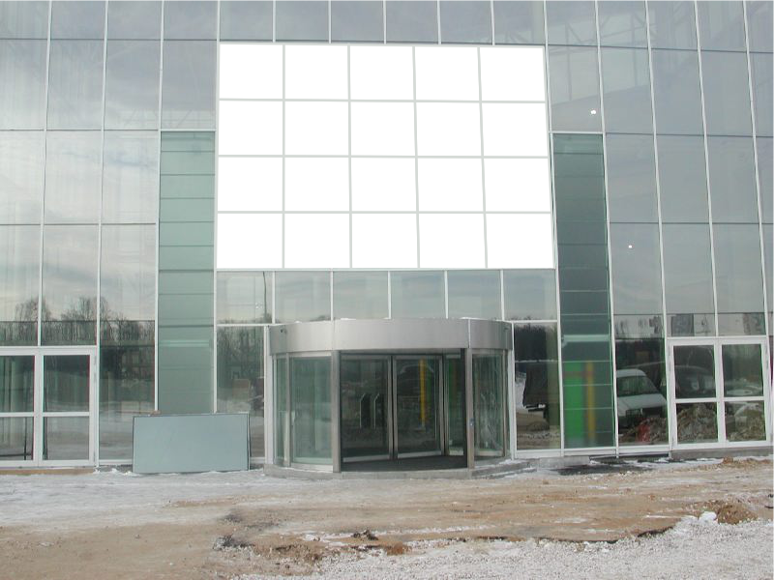


Slide 18

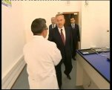

Slide 19
Technical specifications of stained glass system “Window/Screen”
Parameter | LED screen | Proposed screen
Pixel |  | 1R1G1B
Rated power, W/sq.m | 350 | 190
Maximum power, W/sq.m | 700 | 390
Brightness, cd/sq.m | ?5000 | ?5000
Distance of view | from 14 meter | from 14 meter
Degree of protection | IP65/IP54 | IP65/IP54
Angle of view | H=120º, V=60º | H=120º, V=60º
Control method | Synchronization with PC, software included | Data transfer via Wi-Fi
Lifetime | > 50 000 hours | > 100 000 hours
Range of operating temperatures | -20 to +65 | -20 to +75
Screen thickness | 35 cm | 4 cm
Transparency in the initial state | 0 | 85%

Slide 20
Technical and economic characteristics of the module
The spatial resolution is 980 pixels per square meter
Fixing: aluminum frame, ready-to-assemble screen attached directly to the architectural supporting structures
Basic product: standard double-glazed item

Slide 21
Thank you for your kind attention

