Slide 1


Посольство Республики Корея в Казахстане
Корейское научно-техническое общество «КАХАК»
Казахский национальный университет им. аль-Фараби
Energy Cost Minimization for Small Building with Renewable Energy Sources Based on Prediction Control
Viktor Ten, Zhandos Yessenbayev, Akmaral Shamshimova, Albina Khakimova
Nazarbayev University, NLA
Almaty, 2015

Slide 2
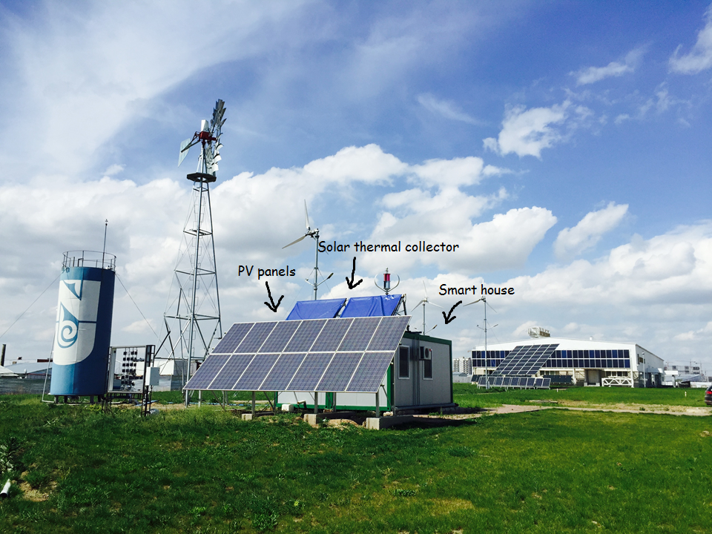
Renewable Energy Test Site at Nazarbayev University, Astana, Kazakhstan

Slide 3
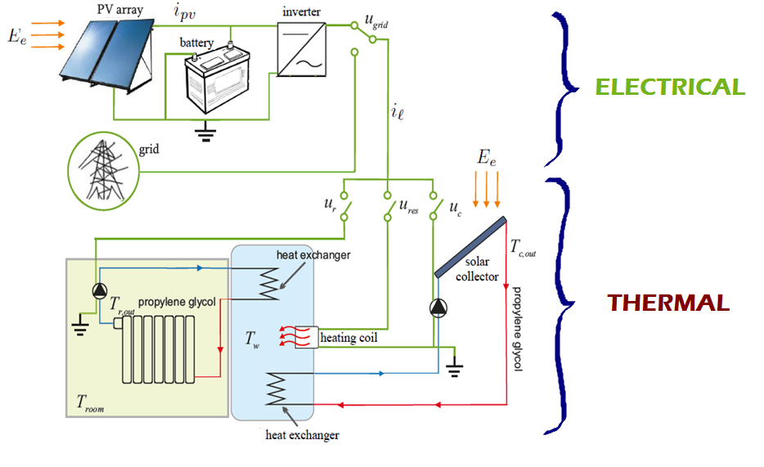
Control Plant is a combination of two subsystems:

Slide 4
Objectives and Implementation
Objective – simultaneously satisfied requirements:
maintain the indoor temperature within a comfort zone;
satisfy demand of electrical power from the electrical loads;
minimize overall consumption of energy sourced by grid;
minimize cost of consumed energy.
Implementation algorithm:
obtain a control oriented state-space model which captures main thermal and electric dynamics, activation of the pumps, heating coil and the connection to the grid → system identification;
define operating constraints including logic constraints and limits on the system variables;
design an controller with preview capabilities on desired room temperature, electricity tariff, outside temperature and solar radiation:
Model Predictive Control (MPC),
Control based on Genetic Algorithm.

Slide 5
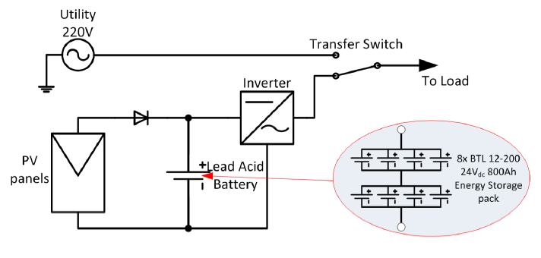
Electrical subsystem
Q = 800 Ah
Sample at T_{s} = 10mins
Load can be powered either directly by the grid (u_{grid}=1) or by the battery bank through an invertor (u_{grid}=0)
Current generated by PV is assumed to be linearly proportional to solar radiation(coefficient obtained by a linear regression):

Slide 6
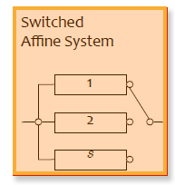
Thermal Subsystem
State vector:
Disturbance input vector:
Discrete-time model structure:
Grey-box model:
Model is nonlinear → convert to a linear system with hybrid dynamics
4 possible combinations of → 4 linear
models combined into a switched linear system
The coefficients of matrices A, B and D were determined using a simple linear regression

Slide 7
Overall system
β_{forecast}
System
T_{amb}, E_{e}
PV
i_{pv}
I_{load}
U_{load}
SoC
Battery pack
Resistor On/Off
Pumps On/Off
Grid/Battery
Controller
T_{room}
Thermal model
€
Discrete states: x(k) = temperatures, state of charge at time k
Discrete output: y(k) = temperature tracking error at time k
Discrete disturbances: d(k) = outside T, solar radiation, tariff at time k
Binary inputs: u(k)= grid/battery switch, pumps on/off, resistor on/off at time k

Slide 8
Control Task
Stabilization problem: maintain all states of the system within the required ranges:
Optimal control problem: minimize the cost function – analogous to the overall electricity cost
The input sequence for optimal behaviour

Slide 9
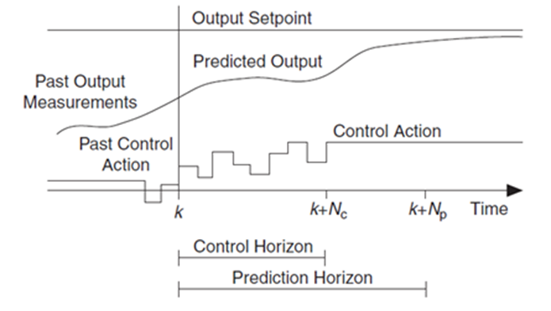
Model Predictive Control (MPC)
Theory behind MPC
MPC is based on iterative, finite-horizon optimization of a plant model.
At time t the current plant state is sampled and a cost minimizing control strategy is computed (via a numerical minimization algorithm) for a relatively short time horizon in the future: [t,t+T].
Specifically, an online or on-the-fly calculation is used to explore state trajectories that emanate from the current state and find (via the solution of Euler–Lagrange equations) a cost-minimizing control strategy until time t+T.
Only the first step of the control strategy is implemented, then the plant state is sampled again and the calculations are repeated starting from the new current state, yielding a new control and new predicted state path. The prediction horizon keeps being shifted forward and for this reason MPC is also called receding horizon control.

Slide 10

Model Predictive Control (MPC)
Principles of MPC:
Model Predictive Control (MPC) is a multivariable control algorithm that uses:
an internal dynamic model of the process
a history of past control moves and
an optimization cost function J over the receding prediction horizon, to calculate the optimum control moves.
An example of a non-linear cost function for optimization is given by:
without violating constraints (low/high limits)
With:
x_{i} = i-th controlled variable (e.g. measured temperature),
r_{i} = i-th reference variable (e.g. required temperature),
u_{i} = i-th manipulated variable (e.g. control valve),
w_{xi} = weighting coefficient reflecting the relative importance of x_{i},
w_{ui} = weighting coefficient penalizing relative big changes in u_{i}, etc.

Slide 11
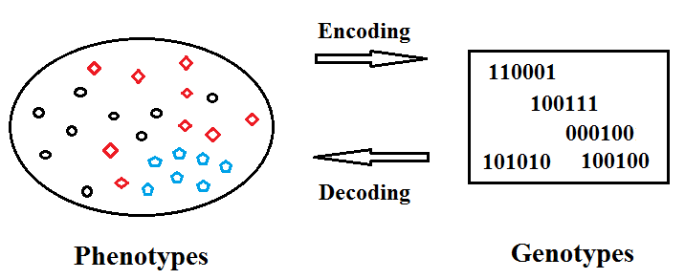
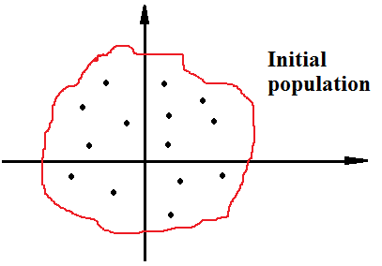
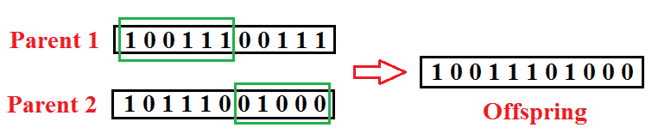
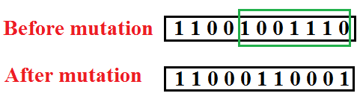
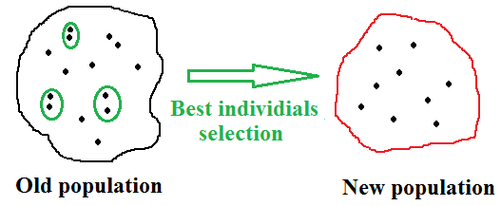
Genetic Algorithm (GA)
GA – a heuristic evolutionary optimization algorithm
Representation:
Population initialization:
Crossover:
Mutation:
Selection:
  parents selection
  best individuals selection

Slide 12
Genetic Algorithm (GA)
Start
General procedure of GA
Initial population
Notes:
Population generation must respect the constraints
Elitism might be used in population generation
Fitness evaluation
Stop?
Selection
No
Crossover
Yes
Final population
Mutation
Renew population
Finish

Slide 13
Genetic Algorithm (GA)
GA specifications in MATLAB
Parameter | Value
Representation | Binary vector u(k) = [u_{grid}(k), u_{res}(k), u_{c}(k), u_{r}(k)] stacked together for each time k, T = 2880
Fitness function | Energy cost as described above
Constraints | Non-linear constraints described as above
Initialization | Uniformly
Selection function | Stochastic uniform (walk through random intervals)
Crossover function | Scattered algorithm (mask random binary vector)
Mutation function | Gaussian distribution (add a random number with mean 0)
Generation size | 500 chromosomes
Elite count | 2
Termination criteria | Stall generation (=20) + Function tolerance (=10¹⁰)

Slide 14
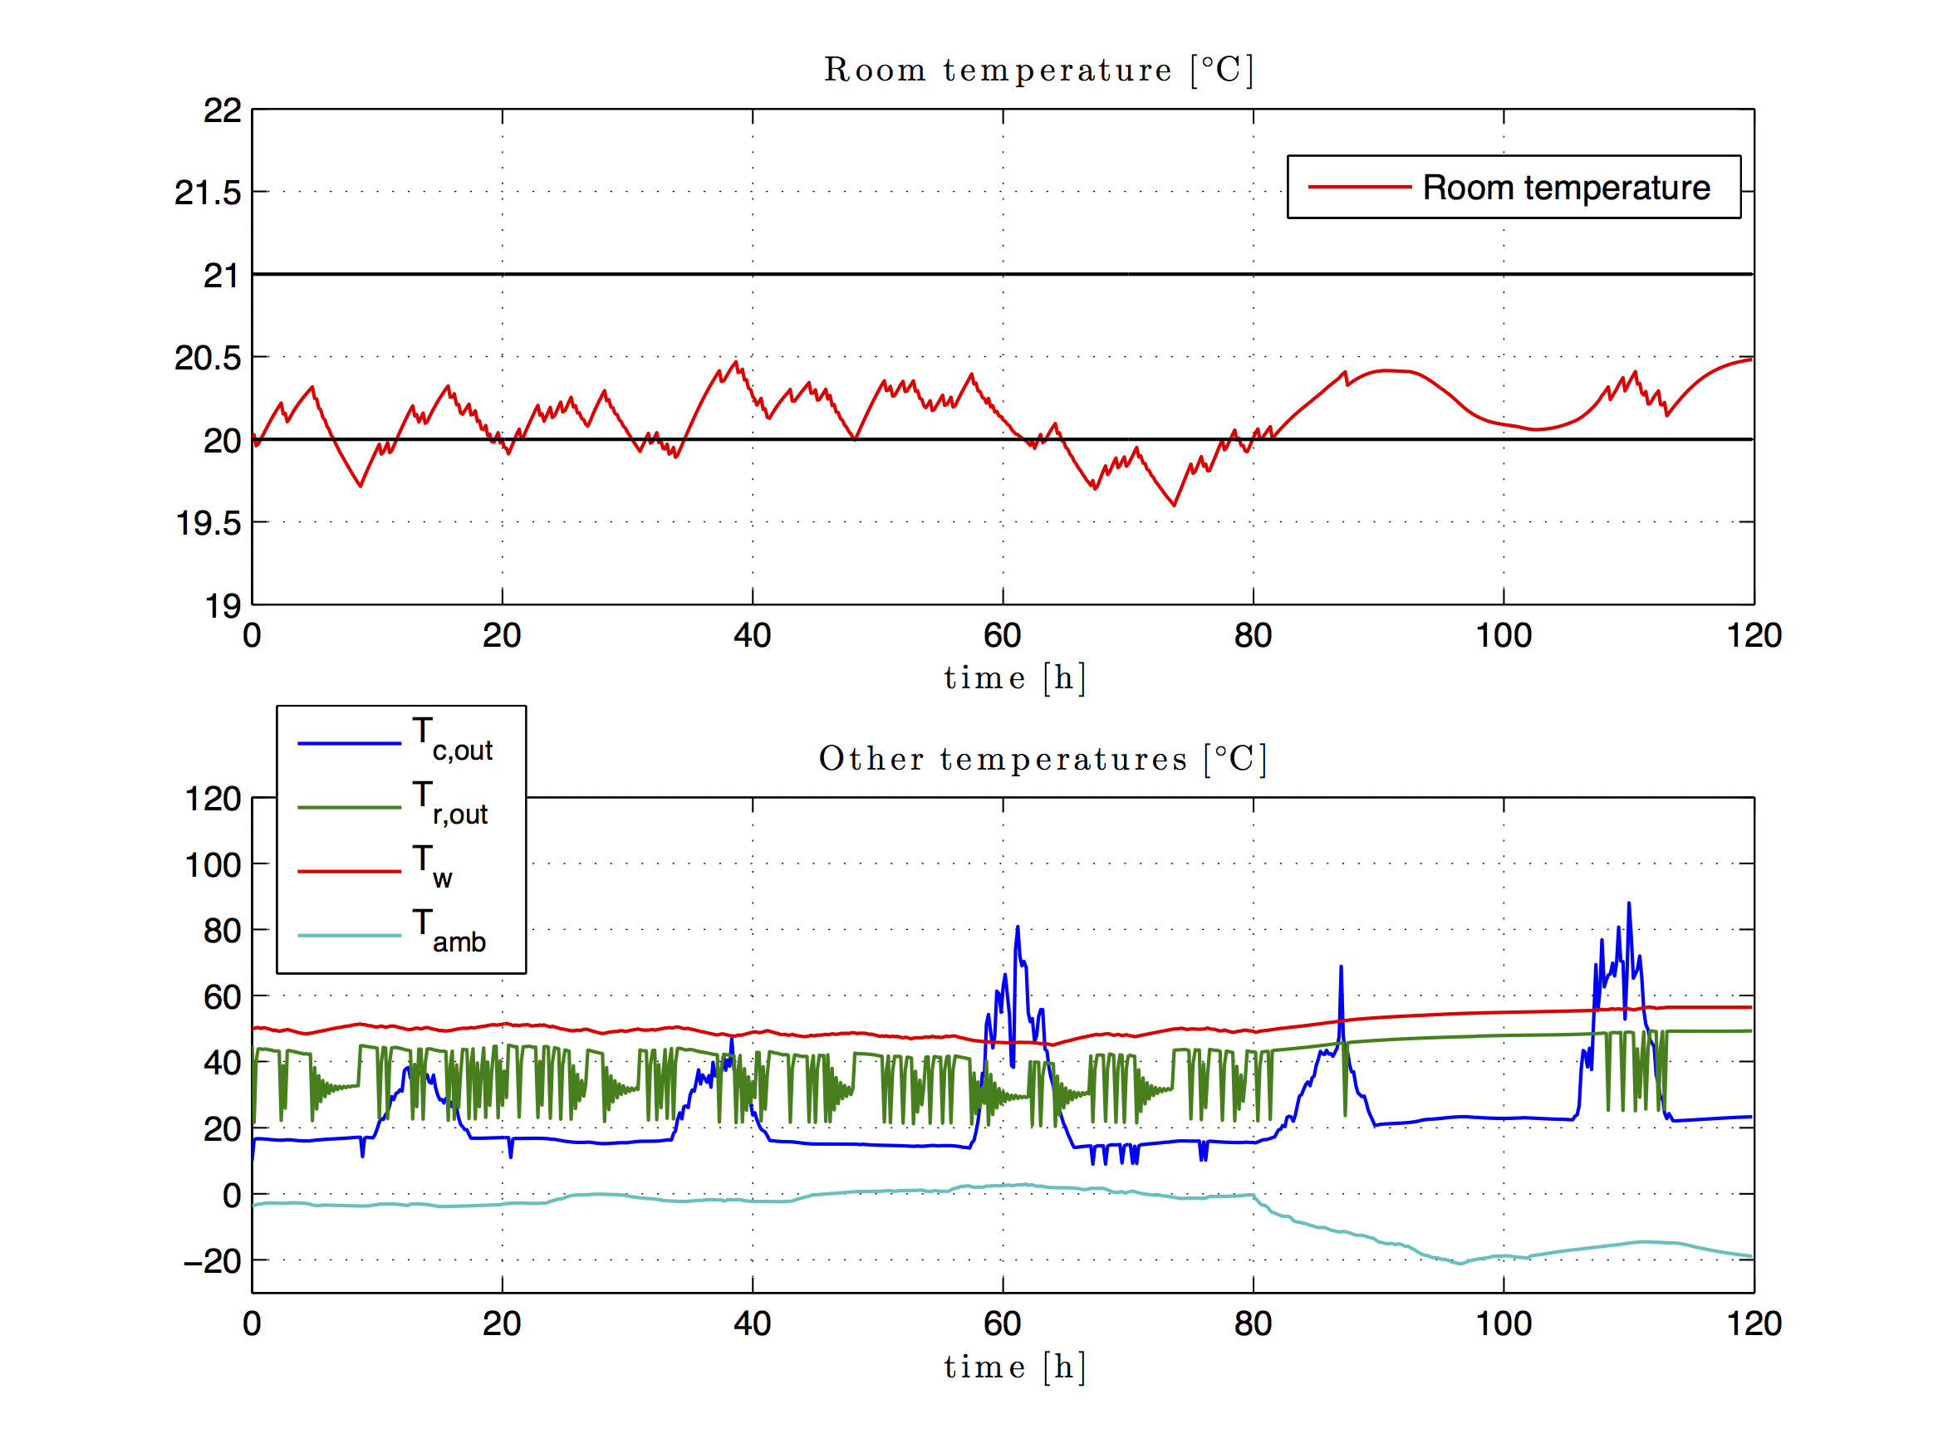
MPC Simulation results
Controller: Ts=30 mins, Prediction: 8 hours; N=16;
Simulation: 5 days; Ts=10 mins Economy: ~ 3 EUR (European Tariffs)

Slide 15
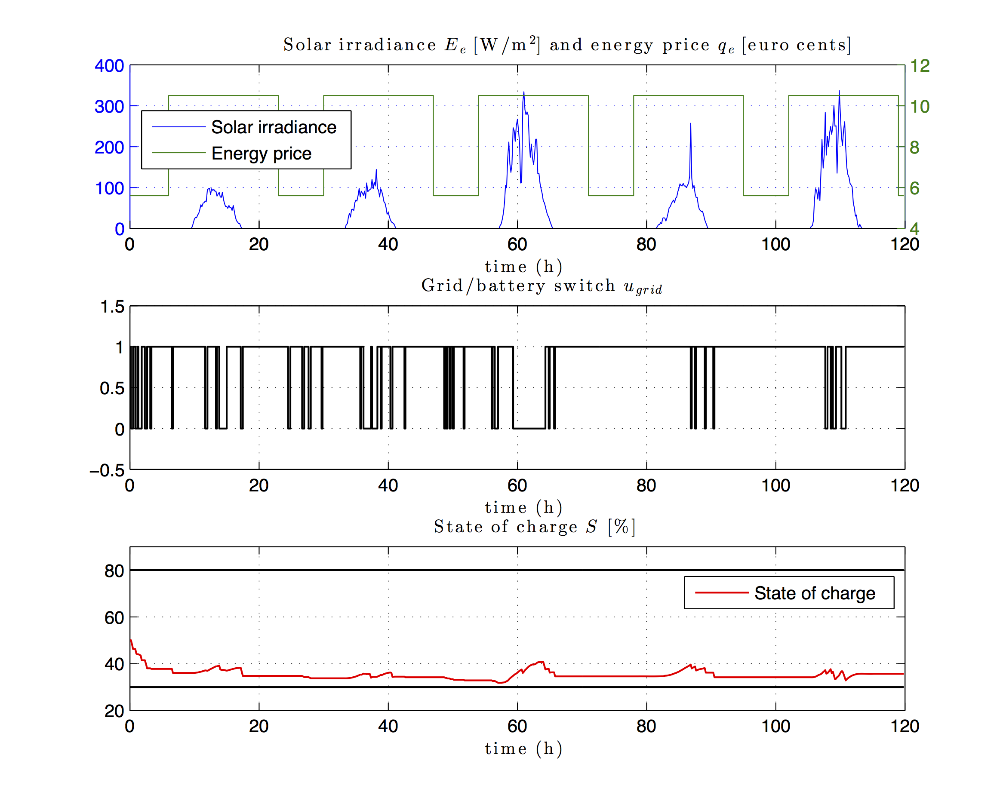

Slide 16
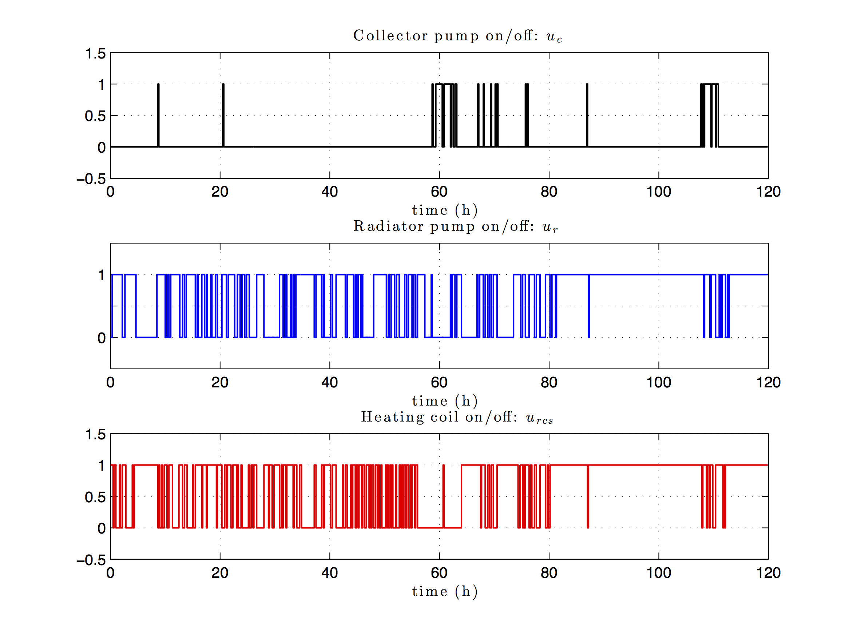

Slide 17
GA Apply Simulation Results
Controller: Ts=30 mins, Prediction: 8 hours; N=16;
Simulation: 5 days; Ts=10 mins Economy: ~3 Euro

Slide 20
Acknowledgements
Organizers of the seminar and ‘Kahak’ staff:
Пак Иван Тимофеевич, проф., почетный президент НТО «Кахак»,
Мун Григорий Алексеевич, проф., президент НТО «Кахак»,
Ю Валентина Константиновна, проф., вице-президент НТО «Кахак»,
Югай Ольга, зам. отв. секретаря журнала «Известия НТО Кахак», и др.
Research Team and Administration of NLA at NU:
Prof. Alex Tikhonov – Director for Center for Energy Research,
Dr. Zhandos Yessenbayev – Senior Researcher,
Akmaral Shamshimova – Junior Researcher,
Albina Khakimova – Junior Researcher,
Dana Sharipova – Research Assistant,
Aliya Kusatayeva – Junior Researcher, and others.
Thank you for attention!

